Slide 1

GBS Cloud Strategy & Offerings
Sep, 12th, 2015
Max Lee
Scrum Master & CCRA 4 certification

Slide 2

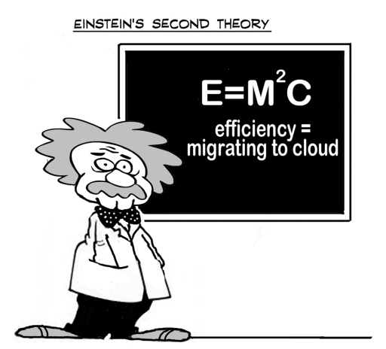
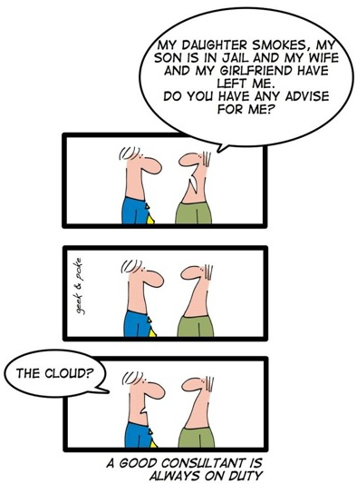
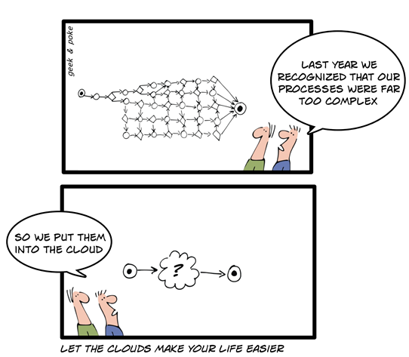
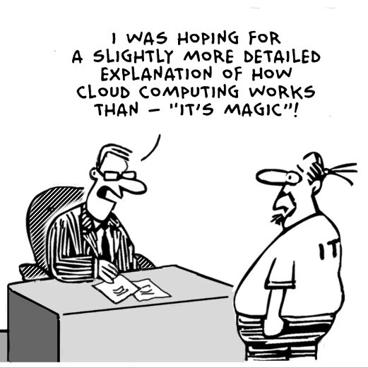
Cloud!

Slide 3
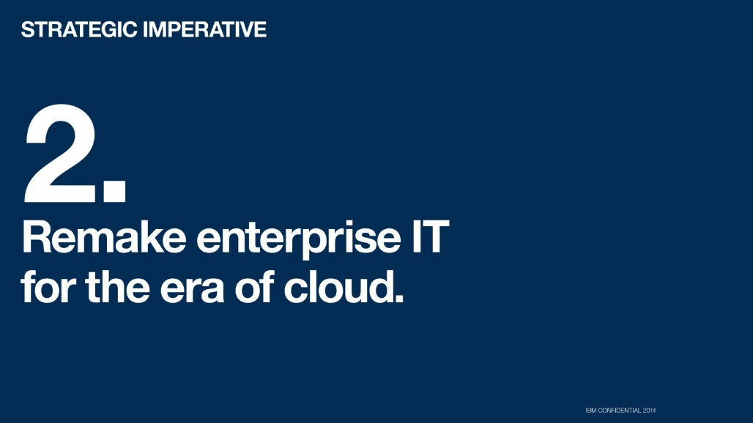
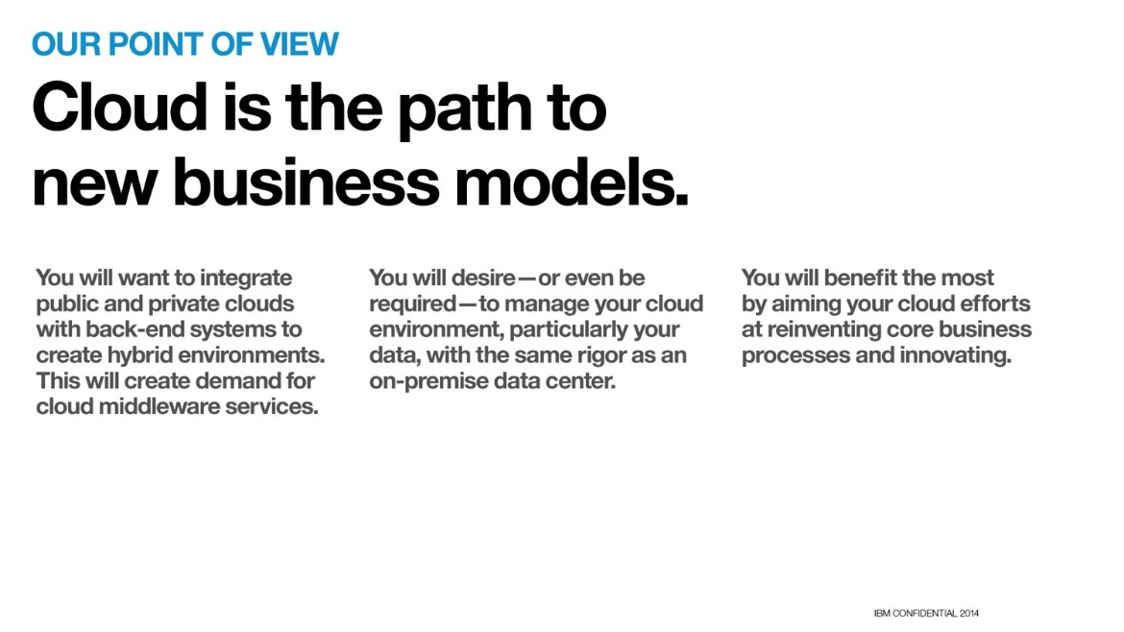
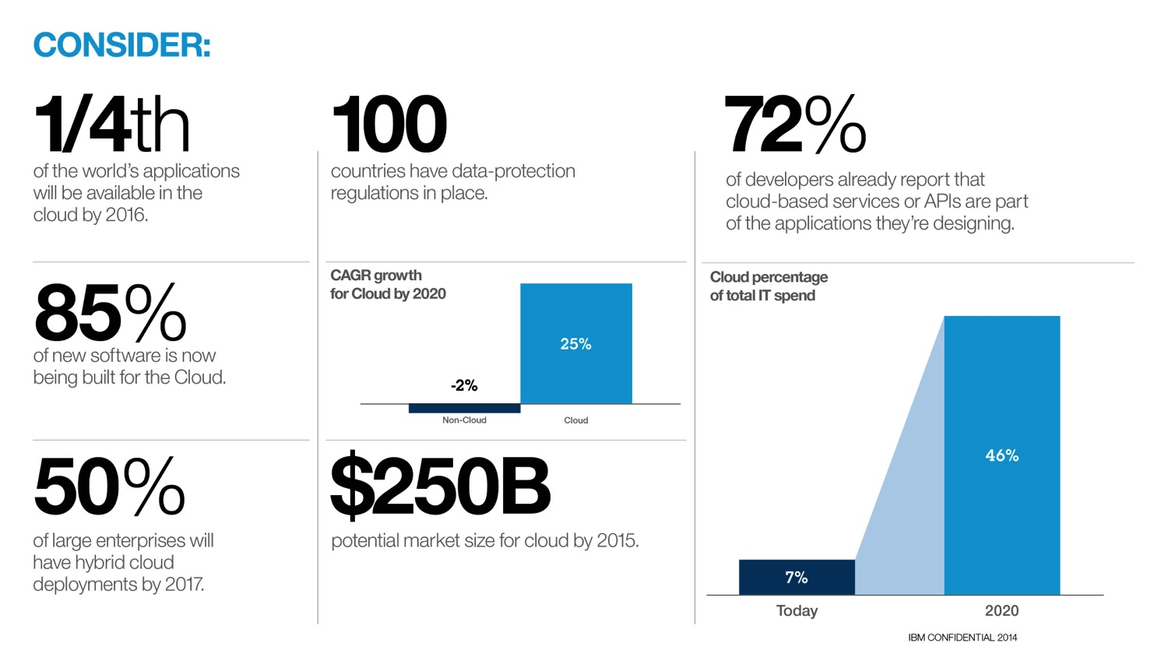
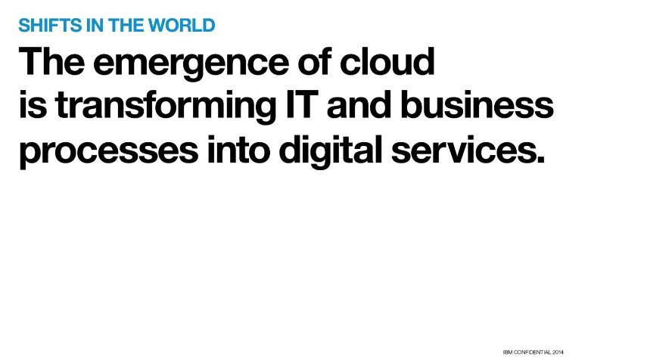
Cloud is a cornerstone of the IBM and GBS strategy 2014.

Slide 4

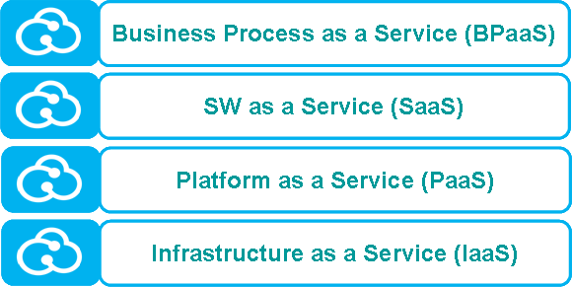

Cloud solutions provide real benefits to our clients.
Cloud offers “game changing” business enablers …
…empowering organizations to optimize, innovate or disrupt their operating and business models
Cloud’s Business Enablers
Digital Transformation Framework
Cost Efficiency & Flexibility
Business Scalability & Elasticity
Disruptors create radically different value propositions, generate new customer needs and segments. They disintermediate existing industries or even create new ecosystems
Innovators significantly extend customer value propositions resulting in new revenue streams and transform their role within their industry or enter a different industry ecosystem
Optimizers use the cloud to incrementally enhance their customer value propositions while improving their organization’s efficiency
Time-to-Market / Market Adaptability
Disruptors
2
3
Create
1
Value Chain
Innovators
Transform
Improve
Optimizers
4
GIE
6
Context-driven Variability
5
Inter-Company Ecosystem /
Intra-Company Geographical Connectivity
Enhance
Extend
Invent
Masked Complexity
Customer Value Proposition
DFO
Data Security & Privacy and Legal Regulations are key topics to consider in client situations, but are often not the roadblocker for establishing cloud solutions!

Slide 5






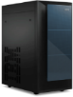


Cloud based solutions are essential to successfully address digital transformation initiatives and build a customer activated enterprise
Digital Transformation
The Customer-activated Enterprise
IBM Global C-Suite Study 2013
Digital Front Office
Globally Integrated Enterprise
Pioneer digital-physical innovation
Customer
Systems of Interaction
Systems of Engagement
Systems of Records
Employees
CRM
SCM
ERP
...
Open up to
customer influence
Business Partner
Cloud
based Services
Network Connectivity
Cloud
based Services
API
API
Craft engaging customer experiences
API
Internet of Things
External
Developers
External
Systems

Slide 6






Cloud capabilities and solutions are essential building blocks of a future corporate IT environment delivering maximum benefits to the business.
Enterprise Business Environment
Business Administration (Finance, HR, ...)
Customer / Channel
BPaaS
Customer / Channel
Cloud enabled
Digital Business Transformation
Customer / Channel
Customer / Channel
Supplier / Partner
Customer / Channel
Product Development
Production & Supply Chain
Marketing
& Sales
Services
BPaaS
BPaaS
BPaaS
BPaaS
Consumability
Enabling new
Business Models & Products
Automating &
integrating Processes
Business Value of IT
Security & Privacy
Delivering actionable
Insights
Efficiency
Connecting People
Innovation
Agility
Corporate IT Environment
IT Operating Model
IT Enterprise Architecture
Cloud based
IT Transformation
Integration & Orchestration (user, process, data)
Classic
IT Solutions
Cloud based Solutions
IoT
(Internet of Things)
IT Governance
SaaS
IT Budgets
IT Organisation
IT People, Skills & Culture
IT Processes
PaaS
IaaS
Cloud Solutions
Network
Business Model of IT
IT Financial Model
IT Sourcing Model
IT Portfolio Model
IT Customer Segm.
IT Vision, Mission, Value Proposition

Slide 7
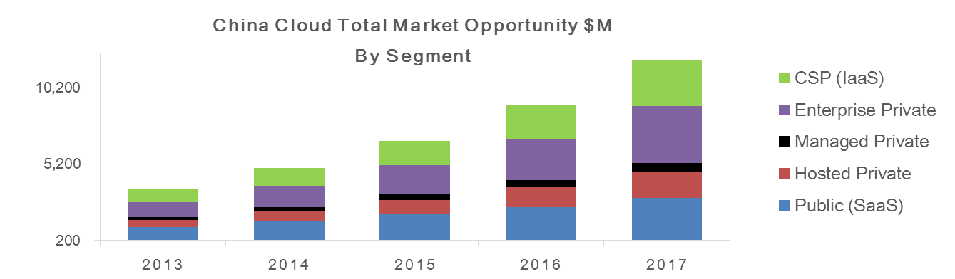
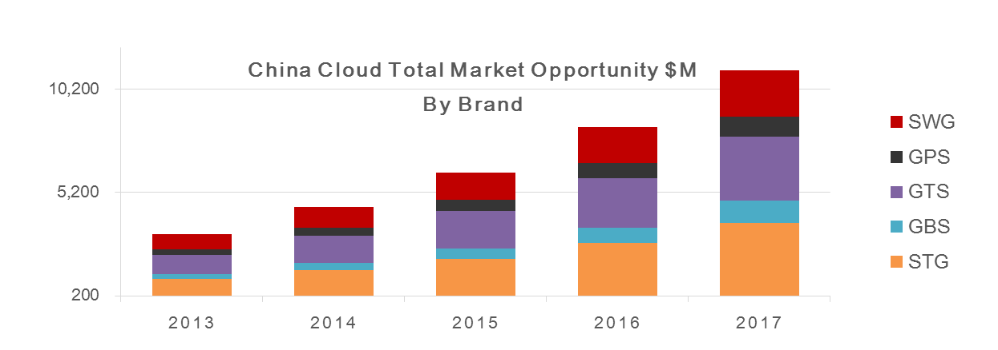
GCG Cloud Market : 5B in 2014
GCG Cloud Objective:
Achieve 2015 Spring plan rev. target: $795M (9% market share), growing to 15% share by 2017
Position IBM as the leader in enterprise cloud services by offering differentiated value
Grow multi-stack IBM deals from just over 10% in 2013 to over 50% by 2015
12B
CAGR 37%
5B
Source: GMV for GCG view, Cross Brand Cloud 2H13, 19 September, 2013 (Plan Rate)

Slide 8







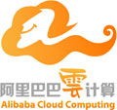









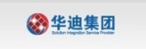


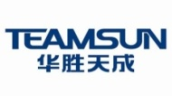
GCG Cloud : Route to Market (where money will be spent)
Private Cloud ~ 2B; Public Cloud ~ 3B
Cloud Enabler
IaaS Provider
SaaS Provider
Cloud User
ISP license
VATS license
Public Cloud
SME
$ 1.4B (Public)
Virtual/Outsource
Private Cloud
$ 1.2B (CSP)
Enterprise
$ 0.7B
(Hosted Private)
Government
$ 0.3B
(Managed Private)
Enterprise
Private Cloud
Government
Solution Provider
System Integrator
$ 1.4B
(Enterprise)
Source: GMV for GCG view, Cross Brand Cloud 2H13, 19 September, 2013 (Plan Rate)
The bulk of GCG Cloud business

Slide 9








GCG Cloud Strategy
Build a base;
Embed IBM-inside Cloud infra;
3. Layer industry-specific SaaS;
4. Establish leadership in Industry Cloud
Industry Solutions
Logistics
Banking
Healthcare
Business Process as a Service
Smarter
Analytics
Smarter
Cities
Smarter
Commerce
Social
Business
4
Re-oriented the Long Term Signing Tiger Team to develop Cloud-based multi-year opportunities engagement (example SuNing)
Land IBM SaaS in China
Expand the ecosystem for offerings already in China
90+ SaaS offerings
Cast Iron
Fiberlink
Social Business
Algo Risk Analytics
Trusteer
Demandtec
Kenexa
Coremetrics
Sterling (B2B NW)
Government and Marketing Coverage: Setting the Cloud Agenda for the China Market
Software as a Service
Need to define entry strategy
Need to address VATS license req’t
Deliver by GDC
Sell direct / via partner
Deliver by IBM local DC
Sell via licensed partner
3
SWG & GBS to provide industry-specific SaaS landing in China and build an ecosystem of ISVs and SIs to sell with & through
Private Cloud
Public Cloud
2
IBM HW and SW inside the Cloud Infra of MSPs, CSPs & Enterprises
Middleware
Services
Platform as a Service
1
Bulk of ~300M in 2013 GCG Cloud and Mgd. Services Revenue
Build and Scale Cloud Infra
Infrastructure as a Service
9
Notes:
9
9
9

Slide 10
2015 Cloud Mission: To be Leading Cloud Provider in GCG Market
538 million in Cloud Rev : 57% yty growth while gaining market share by 1 pts
Establish IBM as the Cloud thought leader with New Clients, New Buyers and New Solution
Drive Hyper Growth in SoftLayer – drive $100m (18 pts share gain) by aggressively expand SoftLayer channel and invest in domestic infrastructure
Increase focus Solution as a Service (SLaaS), Software as a Service (SaaS), and Sell-into-Cloud/MSP – Accelerate ASL/SaaS to drive $34m SW revenue plus GBS SLaaS signing in Public Cloud
Drive higher value SCE+ and PureCloud Managed Service
Design and build Private Cloud at top accounts plus incubating Hybrid Cloud – driving Power8 momentum and creating mega-deal or long-term signing at enterprise and MSP clients.
1
2
3
4
5

Slide 11
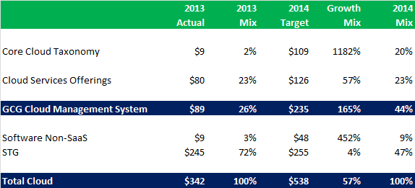
Grow Service Mix in GCG Cloud Portfolio
Grow Cloud mix in GCG business from 7.1% in 2013 to 10.3% in 2014
Grow Cloud “services” mix from 26% in 2013 to 44% in 2014
Double service signing from $180m in 2013 to $340m in 2014, primarily attribute to aggressive SoftLayer $100m signing warrior target
Hence, SoftLayer business & channel development becomes critical success factor for GCG Cloud business in 2014

Slide 12
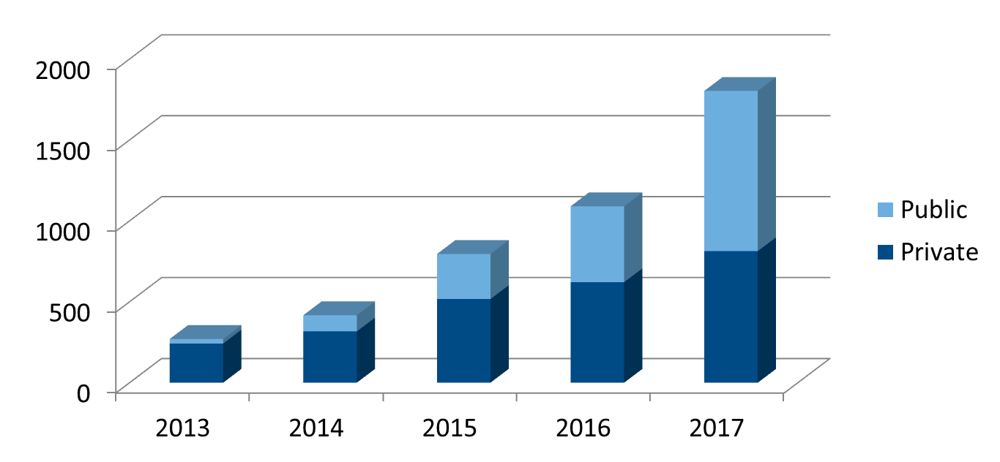
GCG Cloud Aspiration
Achieve 2015 Spring plan rev. target: $795M (9% market share), growing to 15% share by 2017
Absolute leadership in IaaS over local provider, AWS & Rackspace – with 100m SoftLayer, SCE+, 60m PureCloud managed services signing
SaaS leadership through partnership with local players – Heritage ISV/SI, mid-size MSP
References of IBM stack at Big Names Cloud players – Top enterprise hybrid Cloud and Top MSP
2014
Rev: $538m, 57% YTY
GTS 203m
STG 255m
SWG 52m
GBS 28m
Signing: $340m

Slide 13



Global Cloud Sales Plays
Think it.
Strategize how to use
cloud to drive revenue growth and efficiencies.
Build it.
Build and run your private or hybrid cloud.
Tap Into it.
Utilize cloud services delivered from IBM SmartCloud.
1 - Maximize Your Business With a Cloud Strategy and Roadmap (7m) GBS/GTS Cloud Advisory Services | 3 - Build and Extend Your Enterprise Private/ Hybrid Cloud With IBM (300m) GBS Application Services Migration, Testing, Maintenance, ERP GTS Enterprise Cloud Build SWG One 4 Cloud Solution STG IaaS solution HES & PowerCloud PureSystem/System x Cloud CAMP Cloud Storwize, XIV Frame Ahead | 2 - Deploy Fully-Managed Infrastructure and Applications (23m) GBS Cloud Application Management GTS SCE+/Managed Security/Smart End User Support/ Custom SO Cloud
 | 6 - Build Your Service Provider-Grade Cloud Infrastructure With IBM (100m) GTS MSP PureCloud (design, build, run) SWG ASL STG IaaS solution HE PowerCloud CAMP Cloud Storwize, XIV Frame Ahead | 4- Leverage Infrastructure as a Service (IaaS) With IBM SoftLayer (100m) GTS SoftLayer
 |  | 5 - Optimize Your Marketing With IBM Marketing Suite (4m) SWG Enterprise Marketing Suite - Coremetrics, Kenexa, Algo Risk GBS SLaaS solution

Slide 14



Positioning Enterprise Hybrid Cloud
Thought for the day:
"If you are not annoying someone, you are not doing anything new" — Penelope Trunk
Systems of Engagement
Knowledge Sharing Engagement Models Anywhere, Anytime
Systems of Record
Optimize IT infrastructure, data and processes
Drives Need
Drives Investment
OLTP
HR
Social
To free funds to continuously fuel innovation, organizations must continuously optimize existing infrastructures to meet new demand.
DB
ERP
Mobile
New methods of interacting with clients and systems are allowing organizations to create innovative new products and services that deliver greater value to clients.
More interactions means more data, which drives the need for more network bandwidth, more storage, more processing power, and more burden on traditional IT infrastructures.
Notes:
Prolific adoption of mobile phones and devices, as well as, smarter products, and instrumented enterprise assets is driving an explosion of data, and enabling new insights from analytics, as well as new opportunities for business. In turn, ‘Big Data’ is placing greater demand on existing infrastructures, driving a need for instant access to resources – compute, storage, and network -- as well as analytics, and other core business and IT applications.
To gain unique competitive advantage, lines of business are increasingly turning to public cloud to quickly access new capabilities and improve time to market for products and services. This puts greater pressure on IT leaders to continue to work strategically with lines of business and achieve the right mix of computing models that can seamlessly meet unique business requirements. All of this while improving the economics of IT and ensuring service continuity and reliability – both on and off premise.

Slide 15

We adress the cloud market opportunity as growth initiative to deliver a significant contribution to the GBS growth model – not as separate stream, but integrated into our Sector / Service operating model
FSS – COM – DIS – PUB - IND
GBS Sectors & Industries
GBS Service Lines
S&T
BAO
SAP
Oracle
AIS
AMS
GBS Growth Initiatives
SmarterCommerce
Social Business
Mobile
Smarter Analytics
Smarter Processes
GBS Cloud Growth Initiative
Key Partnerships
GTS
SWG
Traditional
ISVs
SAP
Oracle
Microsoft
New SaaS
ISVs
SalesForce
WorkDay
....

Slide 16










The GBS Cloud portfolio is structured around the components in the different as-a-Service layers and our associated roles.
GBS as Cloud Solution
Manager
GBS as Cloud Solution Provider
GBS Cloud based
Platform Factories
GBS as Cloud Solution
Implementor & Integrator
GBS as Cloud Solution
Developer
BPaaS
Finance – HR - Operation & Supply Chain – Mktg, Sales & Service
„Classic“ Solutions
SAP
SaaS Solutions
Oracle
SaaS Solutions
Microsoft
SaaS
Solutions
SaaS ISVs
SalesForce,
WorkDay, …
IBM
SaaS
Solutions
GBS
Industry
SLaaS
Client
Cloud based
Solutions
SaaS
GBS
as Cloud
Advisor
SLaaS = Solution as a Service
ISV Platforms
IBM
Platforms
GBS Platforms
PaaS
GBS as Cloud Infrastructure
Consumer
3rd
Parties
IBM
SCE+, SoftLayer
GBS
DST
IaaS

Slide 17

GBS as Cloud Solution
Manager
GBS as Cloud Solution
Implementor & Integrator
We address with our cloud portfolio both point solutions and large scale Business & IT Transformation initiatives across 4 pillars.
GBS as Cloud Solution
Developer
GBS as Cloud Solution
Provider
„Classic“ Solutions
GBS Cloud based Factories
Client specific
Cloud based Solutions
SLaaS
SaaS
GBS
as Cloud
Advisor
Client specific Extensions
IBM
SaaS
Kenexa
Emptoris
....
SAP
SaaS
Success factors
Ariba
...
Oracle
SaaS
CX
SCM
ERP
HR
...
Micro soft
SaaS
Dynamics
...
Sales Force
SaaS
Sales
Mktg
Service
Work Day
SaaS
HCM
Finance
GBS
Assets
...
GBS Cloud based Factories
3rd Party Products
IBM
Products
GBS as Cloud Infrastructure Consumer
PaaS
PaaS
PaaS
IBM
3rd Party
IBM
IaaS
IaaS
IBM
SCE+, SL
GBS
DST
3rd Party
IBM
SCE+, SL
GBS
DST
Cloud Advisory Services
On premise
Cloud based Application Services
Solutions-as-a-Service
Standard SaaS Business Solutions
1
2
3
4

Slide 18
GBS Cloud Offerings Overview
Practice Area | Responsible Service Line | Offering and BVA's
Advisory | Strategy and Analytics (S&A) | Cloud Enabled Business Transformation - BVA
 |  | Cloud E2E
 |  | Cloud Transformation Journey
Application Services | AIS | Cloud Composable Services for the API Economy Assessment
 |  | Cloud Composable Services Development
 |  | Cloud Application Assessment
 |  | Cloud Application Development
 |  | Cloud Development Operations (DevOps) Assessment
 | AMS | Application Migration to Cloud *
 |  | Cloud Migration Rapid Assessment (CRMA) - BVA
 |  | Testing Services for Cloud - Performance Testing
 |  | Testing Services for Cloud – Application Virtualization *
 |  | Cloud Application Virtualization – BVA *
 |  | Cloud Dev/Test Managed Services *
 |  | Cloud Mobile Managed Services *
 |  | Cloud Enterprise Application Managed Services - SAP
 |  | Cloud Enterprise Application Managed Services - Oracle
Independent Software Vendors (ISV's) | Salesforce.com | Salesforce.com Cloud Enabled CRM Service Transformation - BVA
 | Workday | Workday HR and Financial SaaS Assessment - BVA
 | MS Dynamics | Microsoft Dynamics ERP Assessment - BVA
Solutions as Service (SLaaS) | Strategy and Analytics (S&A) | Counter-Fraud Business Controls Software as a Service
 |  | Next Best Action Optimizer (NBAOPT) Software as a Service
 |  | Predictive Asset Optimization Module Library (PAOML) Software as a Service
Enterprise Applications | Enterprise Applications SAP | SAP SaaS Solutions
 |  | Cloud Enterprise Application Managed Services - SAP
 | Enterprise Applications Oracle | SC4Oracle Offering
 |  | Cloud Enterprise Application Managed Services - Oracle

Slide 19
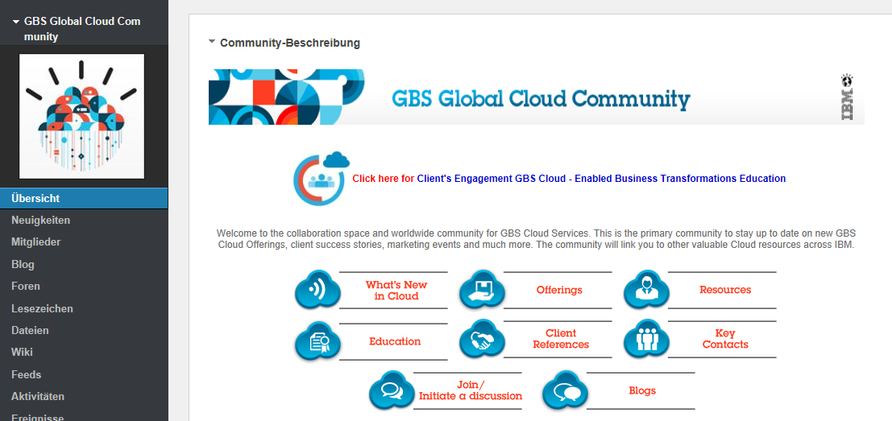
For further information on GBS Cloud, see...
https://w3-connections.ibm.com/communities/service/html/communitystart?communityUuid=d7c4cf37-a0a9-4fe3-a253-503ad90080d2

Slide 20
GBS Cloud Development Operations (DevOps) Offering

Slide 21






Businesses are challenged to meet time pressures with quality software ….34% of all new IT Projects deploy late*
Typical Development – Operations Client Pain Points
41%
51%
45%
experience delays in integration, configuration and testing of applications*
applications rolled back due to quality issues escaping into production*
experience delays due to troubleshooting and fine-tuning issues in production*
Business Owners
Line of Business
Development & Test
IT Operations
Customers
GAP
GAP
4-6 Weeks
Up to to deliver a simple code change**
* Forrester/IBM Study: A New View of IBM’s Opportunity for Integrated Optimized Systems Address , 2011
** Forrester “Five Ways To Streamline Release Management”, 2011
Notes:
IBM INNER CIRCLE 2012
9/11/2015
File Name Here.ppt
21
Q: What do we see in industry today?
A: 41% of organizations experience delays in application installs, 51% of apps rolled back due to production defect, 45% experience delays due to troubleshooting/fine tuning in production. Cycle time – 4-6 weeks to deploy code changes

Slide 22
Typical Development – Operations Client Pain Points
The client has a need to respond to market or competitive opportunities in days or a couple of weeks, many times in support of marketing campaigns and social media.
The client dev/ops tool set is incomplete, poorly integrated, and/or not automated leading to higher costs and quality issues in production.
Provisioning of development or test images with the software stack and data, including reimaging and refreshing test data, takes weeks to months instead of hours.
Change Control (production release) is the gatekeeper trying to ensure bad code doesn’t get deployed, setting up heavy controls and slow release processes to keep production stable.
Metrics and dashboards tying production quality and user feedback to the development and test cycle is missing, incomplete, or manual therefore losing the ability to continuously measure and improve the development and operations integration lifecycle.

Slide 23
IBM Cloud Dev/Test Managed Services provides private and hybrid cloud solutions to meet your development and test needs
IBM Cloud Dev/Test Managed Services provides integrated development and test environments including tools, infrastructure and managed support services (back up, restore, and security) to move you faster from business opportunity to application implementation:
Reduces setup time up to 96% with self-provisioning
Lowers TCO by up to 50% for Dev/Test
Moves from CapEX to OpEX for Dev/Test infrastructure
Lower business risk with comprehensive unified security services
Keeps your team productive with middleware services
Focuses your resources on your applications, not your infrastructure and the maintenance of it
Reduces time to market up to 60% for your application development and testing projects!
Integrated
Flexible
Scalable
Leverages the full capabilities of IaaS, PaaS, and Managed Services.
Provides global dev/test support and remote access .
Provides fast turnaround (hours not days) to provision servers
Allows you to increase and decrease capacity as needed…instantly
Scales the dev/test environment with virtual machines at the rate required by the business
Replicates the environment consistently to enable concurrent dev/test cycles

Slide 24



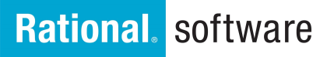

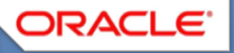
With IBM Cloud dev/test managed services, you can get support for your entire suite of development and test systems in one place
Additional Cloud Managed Services Solutions
Private
Public
Hybrid
Cloud Mobile Managed Services
Development
Cloud Agile Development Platform
Project Startup
Test
Maintenance
Middleware
Cloud Enterprise Application Managed Services for SAP
Infrastructure
Security
Compliance
Backup and Recovery
Cloud Enterprise Application Managed Services for Oracle

Slide 25
Standard cloud development and test bundles accommodate small, medium and large project needs
Small Cloud Dev/Test Project
(58% of Cloud Projects)
Project Characteristics | Solution
Small team (Dev) WAS, DB2 Includes optional backups and middleware support Optional Virtual Private Network (VPN) support | 1x Application server (Linux, 2 CPU’s, 4 GB RAM, 20 GB Disk) 1x Database server (Linux, 2 CPU’s, 4 GB RAM, 40 GB Disk)
Medium Cloud Dev/Test Project
(33% of Cloud Projects)
Project Characteristics | Solution
Mid-size (Dev, Test, Staging) WAS (Clustered), DB2, and IHS Includes optional backups and middleware support Optional Virtual Private Network (VPN) support | 2x Application servers (AIX, 2 CPU’s, 2 GB RAM, 50 GB Disk) 2x Database servers (AIX, 2 CPU’s, 2 GB RAM, 50 GB Disk) 1x Application Server (Windows, 2 CPU’s ,2 GB RAM, 50 GB Disk)
Large Cloud Dev/Test Project
(9% of Cloud Projects)
Project Characteristics | Solution
Large Team (Dev, Test, Staging) WAS (Clustered), DB2 (Clustered), IHS, and MQ Includes optional backups and middleware support Optional Virtual Private Network (VPN) support | 6x Application servers (Linux, 4 CPUs, 4 GB RAM, 60 GB Disk) 3x Database servers (AIX, 4 CPUs, 8 GB RAM, 120 GB Disk) 2x Web servers (Linux, 2 CPUs, 2 GB RAM, 30 GB Disk)
Note: Windows licenses included. Other licenses are the responsibility of the client.
Notes:
25

Slide 26
Complementary managed support services keep your environment safe, compliant and running …which means teams can be more productive
Large Cloud Dev/Test Project
Medium Cloud Dev/Test Project
Small Cloud Dev/Test Project
Middleware Support
Network Support
Backup and Recovery
Technical expertise including: Middleware installation, configuration, and trouble shooting Install software maintenance Automated monitoring of middleware Fully automated network and security monitoring Security patch installation Specialized Middleware Expertise / Support for: Apache, Cognos, DB2, Domino, Citrix, Windows Terminal Server, IBM HTTP Server, DataStage/IIS, MQSeries, Oracle DB, SQL Server, Websphere, Domino, TSAM Cloud, TSM and Worklight | Wide array of network services including: Troubleshoot, compliance and VPN services Troubleshoot network problems within controlled networks Compliance with IBM internal security standards Firewall administration External connection monitoring and troubleshooting Site to Site and Client to Site VPN services | Backup services designed to back up client data, at the file or database level, and be able to reliably restore that data. Initial Tivoli Storage Manager (TSM) setup and configuration Initial TSM backup, TSM Backup monitoring Troubleshooting and resolution of any TSM related backup issues Restores from TSM backup as needed Ad hoc TSM backup requests
Protect your environment from network threats and viruses
Mitigate risk by applying unified security policies across all environments
Ensure your systems are patched and backed up automatically

Slide 27
IBM Cloud Dev/Test Managed Services provide the option to select and connect the cloud suitable for your business
Full Service
Self Service
Hybrid Cloud
IBM team creates and manages the environment for the project team | Client can add virtual servers, increase capacity, and open support tickets | Combination of public and private clouds
Hybrid Cloud
IBM Private Cloud + IBM Public Cloud
Jointly Managed
Private Cloud
Full Service
IBM Managed
Public Cloud
Self Service
Client Managed
Hybrid Cloud
Client Private Cloud + IBM Public Cloud
Client Managed

Slide 28
Get started with IBM Cloud Dev/Test Managed Services
Identify an Operational objective to support and demonstrate value-add
Value
Conduct an assessment and define a roadmap to realize your Strategic, Tactical and Operational Dev/Test Solution objectives
Scale
Proof of the business case
High level business case
Actionable plan
Grow the value by scaling IBM Cloud Dev/Test Managed Services to support the enterprise Strategic, Tactical and Operational Dev/Test Solution objectives
Demonstrate
Assess
Competitive advantage
Maturity
Notes:
Thank you at end

Slide 29
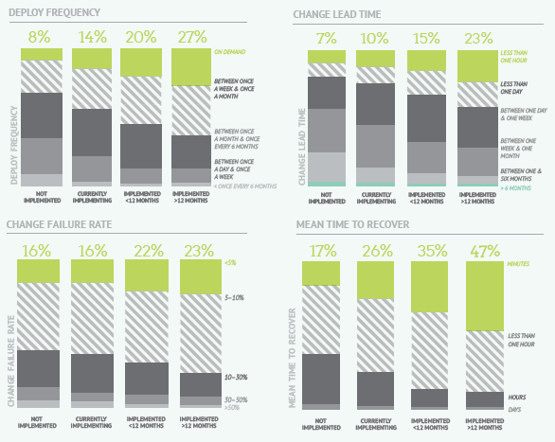
Cloud Dev/Test Managed Service is driving value in responsiveness, quality, and development cost
Over 4000 respondents world-wide, 63% with some level of DevOps implementation
Those with DevOps
Ship code 30x faster
50% fewer failures
Restore service 12x faster
Deploy 8000x faster
than their peers without DevOps
Some key inhibitors
48%: Value of DevOps not understood across the organization
43%: No common management structure between Dev and Ops
33%: Lack of tools
Source: Puppet Labs & IT Revolution Press, 2013

Slide 30
Projects can move to the cloud anytime in the application lifecycle
Provision ready-to-go systems and begin development on day one
Add capacity as needed
Conduct software evaluation, Proof of Concept without waiting on hardware
Sales Support
Development
Project Startup
Test
Clone environments to allow for overlapping test phases
Accelerate integration testing
Scale down instantly
Can even deprovision all servers until maintenance is actually needed (e.g. bug fix)
Maintenance
Notes:
Include a “start here” message if we know where the client is looking to incorporate Cloud
This chart can be easily customized toward the type of work, industry, project size etc.
Bottom line: You do not need to start with a brand new project to take advantage of the Cloud. Start anywhere, and push to the areas where desired

Slide 31
DST Services & Commercial Value Proposition GBS Smart Cloud Dev & Test Solutions

Slide 32










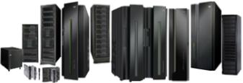
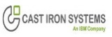




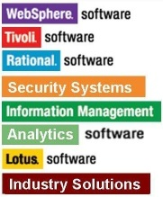




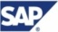





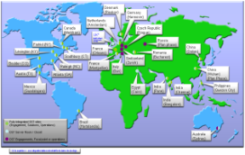
DST at a glance - an IBM GBS ‘home field’ advantage
The IBM Development Support Team ‘DST’ is a worldwide GBS global center of competencies based on a team of experts providing optimized "end to end" Development Solutions for Internal and Commercial Application Development workload. With over 12 years experience in running large scale environments, DST provides a whole set of offerings from Demo-Sand-Box to Development, Test & PoC capabilities.
High-Level Expertise
Unique GBS investment of 650+ highly-skilled IT hardware & Software Specialists, Architects, Project Managers and Application Development consultant delivering high level of support.
650 experts in 31 locations
2% Sales & marketing
10 % Engagement
24% Design Solution
64% Delivery Solution
Latest Technology
Significant technology available for customers remotely in the DST private cloud or dedicated, include latest Systems x, SoftLayer, Power, iSeries, System z, SUN, Network, Storage & Mobiles.
Smart-Cloud Mobile Dev platform, IBM Mobile first architecture compliant.
Latest Software, Middleware, Solutions.
Significant software images available thru the DST Smart Cloud: OS, Virtualization, Middleware, Mobile development, Rational Dev tools, Analytics, Oracle & SAP Solutions, DevOps UrbanCode-Chef Solutions.
Cloud Managed services, Social, Mobile, Analytics, Big Data, SoftLayer, Managed Security, Rational dev Tools GaiN Jazz Agile, DevOps UrbanCode/Chef.
Geo dispersed Data center Facilities
More than 23 worldwide datacenter dispersed in 14 countries delivering secured and fully featured Development & Testing platforms, ITCS104 compliance & Yellow zone security Network access.

Slide 33
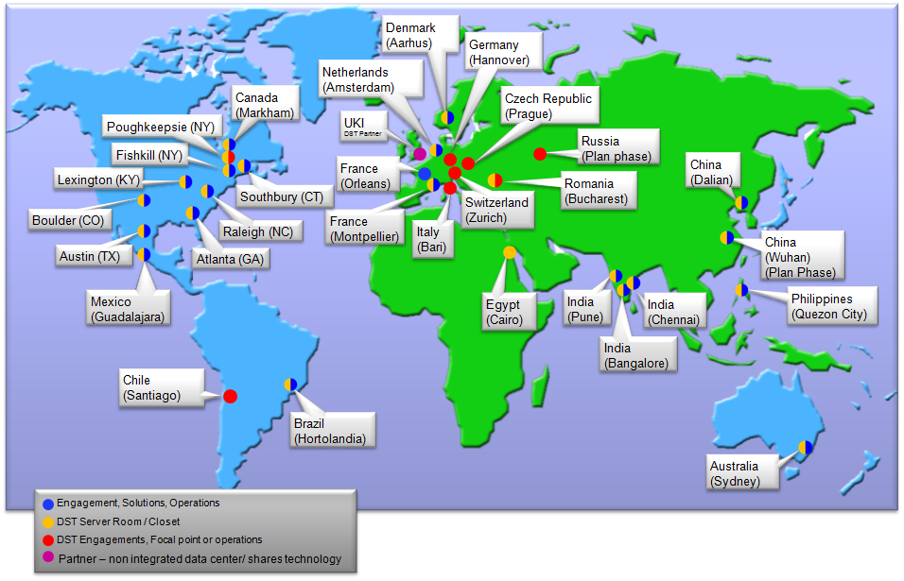
DST WW Locations
23 DST datacenter dispersed in 14 countries

Slide 34
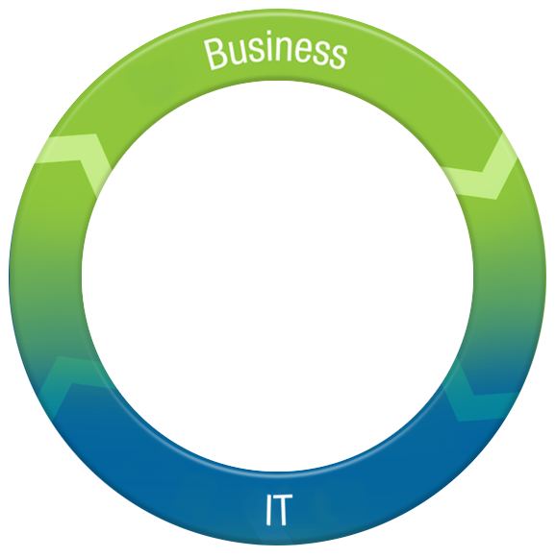
DST Strengths & Positioning
Go to Market
Clients
BPs
IBM’ers (DST is a cost center)
Industry Application Development Solutions
Banking, Insurance
Telco, Retail
Government
Electronics,
Energy & Utilities
Healthcare, Media
Oil & Gas
Transportation
Plays & Solutions
Application development
Smart Cloud Dev&Test
BAO/Big Data Dev&Test
Mobiles Dev&Test
Social Business Dev&Test
Cloud Architectures
Managed Security
Application life-Cycle Mngt
DevOps Solutions
Application Development Managed Services in the cloud IaaS PaaS SaaS Latest Technologies, Software & Solutions, Application Development support
System z, System x, Power, Pure Systems, PureData, Storage, Network, iSeries, SUN Solaris (In the Cloud or Traditional), Softlayer Systems & Managed Services.
Software (OS-Virtualization & middleware), Development toolkit (Rational GaIN, Jazz, Agile), Industry Solutions (Oracle, SAP, PeopleSoft, Mobile, Analytics), DevOps (UrbanCode, Chef).
Cloud Managed Services for Application Development & Test workload, Design Solution & Cloud architecture, Managed Security, ITCS104 compliance, Yellow zone Network access
Notes:
34

Slide 35



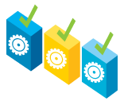



Collaborating with DST
Collaborating with DST helps Software application developers to focus on their core competencies in a highly flexible, unconstrained environment. Developers can benefit from support provided by experts in Dev/Test infrastructure, Middleware, Solutions, developments tools methods and best practices.
DST Offerings
Type of Services available
Managed Security Services
Environmental Hosting (Cloud & Traditional)
Cloud Dev & Test platform
Mobile Dev & Test platform
Development & Test tools
Traditional Dev & Test platform
DevOps UrbanCode Deploy
Cloud Managed Services
Managed Security Services
Sand-Box, Demo’s, Training platforms
PoC & Performances Testing
Backup Services, Ticketing System
Smarter Mobile Development
DevOps Deployment
Instance Security, OS, Network support
Application Tool & Methodology Support
Middleware Support / Expertise
Extremely Fast
Cost Effective
Flexible & Efficient
Global
Support
Standardized
Risk Compliant
Available Inventory

Slide 36

SmartCloud capability comparison & Cross brand delivery
Capability | DST SmartCloud | Softlayer | SCE +
xSeries |  |  | 
pSeries |  |  | 
zSeries | 
iSeries | Traditional hosting
Infrastructure Resiliency |  |  | +
Operating System Support |  |  | 
Security Support (ITCS104 compliance) |  |  | Cloud ISEC (not ITCS104)
Middleware Support | 
Mobile Development Platform | 
DevOps Deployment | 
Rational Support | 
Application Consulting | 
SAP / Oracle Support | 
Backups |  |  | 
Network Administration (network security zones, firewall admin, port management, SSL certif) |  Blue & Yellow Zones
External access for provision on Cloud |  |  | 

Slide 37




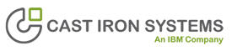


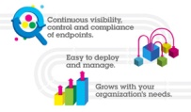
Smarter Mobile Development Platform offering addresses
all aspects of Mobile Application Development & Maintenance
Build & Connect
Manage & Secure
Extend & Transform
Build mobile apps
Connect & run mobile systems
Manage mobile devices and apps
Secure my mobile business
Extend capabilities to mobile
Transform your business
Solution
Develop web, native and hybrid solutions using IBM Worklight
Integrate back end systems and databases via IBM WebSphere Cast Iron through drag-and-drop configuration
Shared Mac hardware
Solution - TEM & MaaS360
Provide BYOD (Bring your Own Device) support via IBM Endpoint Manager & MaaS360
Test and stage fixes before deploying them to the enterprise
Create and validate custom enrollment scripts
Solution
Enable existing Enterprise systems for Mobile
Integrate analytics, commerce, and social business with IBM Tealeaf
Leverage new markets unlocked by Mobile
DST SMDaaS helps you build, manage and extend your Mobile applications, create your environment in hours and leverage the full capabilities of IBM Mobile Foundation in one place with Worklight, Cast Iron, Tealeaf, Endpoint Manager & Rational Dev & Test tools.
Notes:
37

Slide 38
DST Sample cost for standard dev configurations
 | IBM app’s Cloud Dev | SAP Cloud Dev | Oracle Cloud Dev
Small Project Less than 5 Developers Less than 6 months duration | WAS, DB2 Includes backups, m/w support is provided 1x Application server 1x Database server Starting at $1100/ month ($633 one time setup) | 3 Products only (ECC, BI, SOLMAN) Only one landscape (e.g., Dev OR Sandbox) ABAP Stacks Only where possible 3x (4 cores x 16 GB RAM x 300 GB Disk) VMs or LPARs Optional SAP Install/Setup (OTC) Optional SAP Basis Support (Monthly) Starting at $1962 Monthly + $726 OTC (for OS / hardware costs) | One landscape (e.g., Dev OR Sandbox) 1x (4 cores x 16 GB RAM x 300 GB Disk) VMs or LPARs Optional Oracle EBS Install/Setup (OTC) Optional Oracle EBS Support (Monthly) Starting at $868 Monthly + $242 OTC (for OS/hardware costs)
Medium Project Less than 10 Developers Less than 12 months duration | WAS (Clustered), DB2, IHS, and MQ Includes backups, m/w support is provided 2x Application servers 2x Database servers 1x Web Server (dev, test) Starting at $3200/ month ($2000 one time setup) | 6 Products (ECC, BI, SOLMAN, PI, PORTAL, GTS ) 2 landscapes (e.g. Dev AND Sandbox) No 3rd Party Bolt-Ons (e.g. Vertex, Websphere etc) 12x (4 cores x 16 GB RAM x 300 GB Disk) VMs or LPARs Optional SAP Install/Setup (OTC) Optional SAP Basis Support (Monthly) Starting at $7443 Monthly + $2904 OTC (for OS/hardware costs) | 2 landscapes (e.g. Dev AND Sandbox), No Bolt-Ons 2x (4 cores x 16 GB RAM x 500 GB Disk) VMs or LPARs Optional Oracle EBS Install/Setup (OTC) Optional Oracle EBS Support (Monthly) Starting at $1601 Monthly + $484 OTC (for OS/hardware costs)
Large Project 15 developers or more 12 months duration or longer | WAS (Clustered), DB2 (Clustered), IHS, and MQ Includes backups, m/w support is provided 6x Application servers 3x Database servers 2x Web servers Starting at $7700/ month ($5300 one time setup) | More than 6 Products (ECC, BI, SOLMAN, PI, PORTAL, SCM, SRM, CRM, GTS, BOBJ ) More than 2 landscapes (e.g. Dev AND Sandbox AND Test) 3rd Party Bolt-Ons (e.g. Vertex, Websphere , etc) 30x (4 cores x 16 GB RAM x 500 GB Disk) VMs or LPARs 6x (2 cores x 8 GB RAM x 200 GB Disk) VMs or LPARs for Bolt-Ons Optional SAP Install/Setup (OTC) Optional SAP Basis Support (Monthly) Starting at $22059 Monthly + $8752 OTC (for OS/hardware costs | More than 3 landscapes (e.g. Dev AND Sandbox AND Test) Additional Bolt-Ons (e.g. OAS, OIS etc) 3x (4 cores x 16 GB RAM x 500 GB Disk) VMs or LPARs 6x (2 cores x 8 GB RAM x 200 GB Disk) VMs or LPARs for Bolt-Ons Optional Oracle EBS Install/Setup (OTC) Optional Oracle EBS Support (Monthly) Starting at $4992 Monthly + $2178 OTC (for OS/hardware costs)

Slide 39
DST Sample cost for standard dev configurations
 | People Soft Cloud Dev | Smart Mobile Cloud Dev | Rational Dev tools
Small Project Less than 5 Developers Less than 6 months duration | Only one Product (e.g. HRMS or FSCM) Only one landscape (e.g., Dev OR Sandbox) All components on one Host 1x (4 cores x 16 GB RAM x 300 GB Disk) VMs or LPARs 1x (2 cores x 4 GB RAM x 200 GB Disk) Windows VM – Install Workstation Optional PS Install/Setup (OTC) Optional PS Support (Monthly) Starting at $1164 Monthly + $484 OTC (for OS/hardware costs) | Hybrid applications only (Android, Mac), Minimal integration with back-end systems & databases 3x Worklight Studio Windows with Mobile Test Workbench 1x Worklight Studio Mac 1x Worklight Server Starting at $790/month (no one-time set-up fees) | Streamlined IBM Rational solution for Collaborative Lifecycle Management for traditional, agile or hybrid teams. Requirements Management, Team Collaboration and Source Code Management, Test case management 1 Rational CLM Application /DB2 Server Starting at $2022/ month and one time set up of $1172 1x RAD Developer Workstation (optional) Starting at $415/ month, 1x RTW Tester Workstation (optional) Starting at $450/ month
Medium Project Less than 10 Developers Less than 12 months duration | 2 Products (e.g. HRMS and FSCM), 2 landscapes (e.g. Dev AND Sandbox) No Bolt-Ons , All components on one Host 4x (4 cores x 16 GB RAM x 500 GB Disk) VMs or LPARs 5x (2 cores x 4 GB RAM x 200 GB Disk) Windows VM – Install WS and ProcSched Optional PSInstall/Setup (OTC), Optional PS Support (Monthly) Starting at $5167 Monthly + $2178 OTC (for OS/hardware costs) | Hybrid and native applications (Android, Mac), Extensive integration with back-end systems & databases, Use Analytics to improve usability 8x Worklight Studio Windows with Mobile Test Workbench 3x Worklight Studio Mac 2x Worklight Server (dev, test) 1x Cast Iron (shared), 1x Tealeaf CX Starting at $2635/month with a $400 one-time set-up fee | Medium team - 5 developers Add on a full service Build Server to increase performance and productivity 1 Rational CLM Application Server 1 DB2 Server 1 Build Server 5xRAD Developer Workstations Starting at $6295/ month and one time set up of $1859
Large Project 15 developers or more 12 months duration or longer | 3 Products (e.g. HRMS, FSCM and PORTAL) 3 landscapes (e.g. Dev & Sandbox & Test) Distributed components (e.g. DB on one host and Apps on another) 18x (4 cores x 16 GB RAM x 500 GB Disk) VMs or LPARs 10x (2 cores x 4 GB RAM x 200 GB Disk) Windows VMs – Install WS and Proc Sched Optional PS Install/Setup (OTC) Optional PS Support (Monthly) Starting at $17529 Monthly + $6776 OTC (for OS/hardware costs) | Hybrid and native applications (Android, Mac), Extensive integration with back-end systems & databases, Mobile Device Management, Use Analytics to improve usability 15x Worklight Studio Windows with Mobile Test Workbench 5x Worklight Studio Mac 2x Worklight Server (dev, test) 1x Cast Iron (dedicated) 1x EndpointManager, 1x Tealeaf CX Starting at $4491/month with a $400 one-time set-up fee | 10 developers + 5 testers, Extensive integration with back-end systems & databases Add on full service test functionality with the RTW (Rational Test Workbench) workstation and RTVS (Rational Test Virtualization Server) Service virtualization server 1 Rational CLM Application Server 1 DB2 Server, 1 Build Server (additional build servers can be added as needed) 1 RTVS Application Server, 5xRTW Tester Workstations , 10xRAD Developer Workstations Starting at $11811/ month and one time set up of $2115

Slide 40

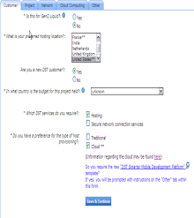
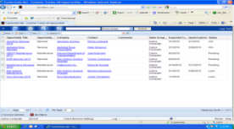
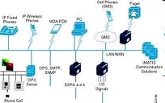






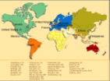

DST Engagement Process - Workflow
CLIENT request received
via Engagement Web Form or mail
http://dst.ibm.com/request_new_environments.php
ENGAGEMENT OWNER
New opportunity entered into DOU DB for Pipeline Management reporting
SOLUTIONS TEAM
Requirements validated & solution designed
Web Form attached
to Ticket & routed
ENGAGEMENT OWNER
ROM provided
CLIENT approves
Average Turnaround Time: A few hours to a day
ENGAGEMENT OWNER
Costing model applied & DOU generated
SOLUTIONS TEAM
Hosting site determined. HW &
resource availability confirmed
Note: DST Provides IBM Costs which need to be put through IBM Pricing before presenting to external client
Costing Model
40

Slide 41
Solutions as a Service (SLaaS) Introduction

Slide 42
Cloud Solutions-as-a-Service (SLaaS) market context
Why are clients asking for Cloud Solutions ‘as a service’?
Increasingly expect integrated solutions – not ‘piece parts’
Seek simplicity and outcomes – over architectures
Want to ‘pay as they go’ for business solutions – not just processing power
Anticipate rapid results – more so than ever before
Are not able to leverage multi-tenant Software-as-a-Service for some business functions – especially for processes that provide a competitive advantage, are highly regulated, or contain confidential data
View cloud to be as much about business and commercial model change as it is about technology
What are Solutions-as-a-Service?
Single tenant; client-specific, personalized for each client’s requirements
Based on existing assets or repeatable patterns, not configurable products
Pricing includes start-up, milestone fees and ongoing subscription or sage pricing
Single client agreement, including the software, consulting services, and hosting
Similar to work that GBS does today developing tailored client solutions, with different consumption model
Cloud is a disrupting software …
Traditional software CAGR: 1% 2008-2020
SaaS CAGR: 25% 2008-2020 and ~20% of the software market in 2015
... And, Services Is Next
Number of large companies have declared intent to procure all technology ‘as a service’
SLaaS opportunities surfacing across the world – very high-level of energy around SLaaS from our Partners/APs
The shift will be fast – business model vs. one that requires high up-front capital
Source: Kelly Chambliss authored collateral on SlaaS
Notes:
42

Slide 43
What are Cloud Solutions-as-a-Service
What is a Cloud SLaaS…
Cloud solution that allows clients to ‘pay as they go’ for tailored, customized capability
Single tenant, multiple software products, enabling one or more business processes
Loosely coupled products, assets, and data sets (‘lego blocks’)
Pricing typically includes start-up, subscription or usage fees and the ability to bring ‘in house’
Client Example: CPG Company Analytics as a Service
Description: Integrated data and analytics engine to manage consumer interactions and integrate multi-channel campaigns under one contract
Pricing: $5-10M over 3 years, milestone and monthly payments - SWG, STG, GBS CS & AMS, GTS BCRS, Softlayer all earn revenue
Products: InfoSphere Data Integration, Gardium Database Encryption Asset, Big Insights Cloud Management, Tivoli Federated Identity Manager, Smart Analytics Console, Neteeza
Solution-as-a-Service
Classic “on premise” solutions
Software as a Service
Business Solution
Business Solution
(Service contract that delivers client value)
Business Solution
App Software
Platform as a Service
App Software
(ERP, Niche Apps)
Infrastructure as a Service
Business Solution
App Software
Platform
Business Solution
App Software
Platform
Infrastructure
Platform
(App Development Platform, Middleware & related Operational Svcs)
App Software
Platform
Infrastructure
Infrastructure
(Server, Storage, Network, OS)
Platform
Infrastructure
Infrastructure
Source: Kelly Chambliss authored collateral on SlaaS; SLaaS workgroup output
Notes:
In first 6 months of 2013, 46% of IBM Profit (10.5B) was derived from SWG license sales and solutions; GBS contributed about 12% or (2.7B)
In 2Q, 19% of SWG New Markets Validated Pipeline ($ TCV) was linked to GBS opportunities (FY2013 overall target is 23%); 3Q is currently averaging 20%
Conversely 49% of GBS New Markets Validated Pipeline was linked to SWG opportunities (FY overall target is 51%)
SWG YtY revenue growth is up 25% for Smarter Commerce and up 16% for Smarter Analytics
In other Market Categories, SWG is also showing very strong YtY revenue growth:
Asset Management (23%), Smarter Process (13%), Social Business (50%), Mobile (113%)
CoCs have grown from 170 to 550 experts, including 155 lab services, 400 GBS experts, with over 100 external hires… Available to sell and construct deals anywhere in the world.
43

Slide 44
What are Cloud Solutions-as-a-Service
Attribute | SLaaS | SaaS | BPaaS
Tenancy | Single tenant; tailored to client requirements | Multi tenant; common code base across multiple clients. Data schemas can also be common. Client customization ability limited to configuration options. | Multi tenant; Underlying software & schemas is typically common code base; Automated process primarily. Any people support is typically in a shared services construct.
Deployment Model | Runs on private or hybrid cloud infrastructure | Public, Private, or Hybrid | Similar to SaaS
Technical Solution Construct | Integrated solution specific to a business imperative that brings together 1 or more SW products, 1 or more assets / patterns. | A single, dominant Software product underlies a SaaS | Integrated solution specific to a business process that brings together 1 or more SW products, 1 or more assets / patterns. Elevated degrees of Process Automation.
Pricing | Annuity-based pricing that includes start-up, often milestone-based fees; ongoing subscription, usage, and/or outcome pricing | Typically no Start-up or 1-time fees. Fully consumption-based pricing – flat fee or usage-based. | Similar to SaaS
Agreement | Single client agreement and integrated pricing across software, implementation services, support services, and hosting | SaaS implementation services can be included along with SaaS consumption in agreement | Similar to SaaS
License Ownership | Client has no ownership of underlying SW licenses, unless client has previous ownership of them. | Client has no ownership of SaaS license. | Similar to SaaS
On-Prem Transition | Client can transition the solution ‘in house’ in the future | Similar to SLaaS | Similar to SLaaS
Support | Ongoing support and enhancement via managed services | Any upgrades to software automatically included in subscription. | Any upgrades to software or standard process automatically included in subscription.
Level of Customization | Tailored client solutions, with different client consumption model | Similar consumption models for all clients. Tailoring limited to configurability of SaaS. | Similar consumption models for all clients. Tailoring limited to configurability of Process and Supporting software.
Business Process Support | Run / Operate of supported Business process is an optional feature. | Not included. | Standard feature.
Source: SLaaS - Kelly Chambliss authored collateral; SaaS & BPaaS – NIST / Gartner defns

Slide 45
SLaaS Criteria
Is the Opportunity recorded in Salesconnect?
Is the solution a 'pay-as-you-go' construct? Are the implementation fees <3x the annual subscription/usage-based value?
Is the solution being deployed on a Cloud infrastructure?
Have you already considered IBM SaaS solutions and determined not feasible – or, that the solution requires additional components and tailoring beyond SaaS? Note that SLaaS is a distinct value proposition above a SaaS
Is the client willing to agree to at least 3 years of ongoing support / maintenance, including termination, or transition ‘in house’, fees?
Will the solution likely include at least 2 SWG products and/or GBS / Research assets?

Slide 46
Predictive Optimization Analytics (POA)
Updated xx-xx-12
Brand / BU | GBS
Announcement Date
eGA Date
Offering Type | Cloud Solution
RFA #
Offering Manager
Marketing Manager
Demand Programs Supported | Cloud & Smarter Infrastructure Asset & Facilities Management Campaign
Sales Kit / Play | <links go here>
PartnerWorld Sales Kit / Play | <links go here>
IBM.com link | <links go here>
Promotional Offers | <links go here>
Offering Overview with Value Proposition | IBM’s Predictive Asset Optimization (POA) solution enables organizations to predict unforeseen asset breakdowns and improve process performance by analyzing equipment data. POA can Make informed operational and maintenance decisions to maximize productive time and increase assets’ life expectancy and increase the overall reliability. It can increase performance and reliability by reducing process inefficiencies to drive higher availability and fewer reworks; improves quality & productivity. The efficiency is improved with maintenance resource optimization; routes based on time and space proximity and crews equipped with proper skills
Client Needs Addressed | POA accelerates time to value with lower risk through reusable assets and an analytics methodology tailored to the clients’ needs of asset maintenance, optimized uptime and improved cost management. Gain visibility into asset health, Lower costs of unscheduled maintenance, Accurately forecast downtime and costs Separate the ‘signals’ from the ‘noise’, Gain visibility of predictors across organizational silos, Leverage analytical insights for asset optimization
What’s New | POA converged with IBM’s Enterprise Asset Management and Analytics capabilities Out of the box solution enables IBM customers to achieve faster time to value Pre-integrated software tools for easier integration to other management tools and applications Enable its customers to predict part quality, which will help improve customer service and experience. Cloud enabled POA makes solutions available faster and more responsive to resource demand
Bundle Components | SPSS, COGNOS, Maximo, Message Broker
Target Market | Aerospace & Defense, Automotive, Chemicals & Petroleum, Electronics, Energy & Utilities, Mining, Manufacturing, Government
Target Audience/ Roles | VPs of Engineering, VPs Products, COOs, CFOs, VP Operations Plant Managers, VP Operations, and Health and Safety Managers
What Non-IBM Offerings Does This Product Compete With? | ABB (Ventyx), Meridium, Bentley (Ivara), Honeywell (Matrikon), among others) to the enterprise application vendors (Infor, Oracle, SAP). Differentiators: Predictive models for a number of specific industry use cases, A tailored and enhanced advanced analytics method for the predictive asset or maintenance space, Pre-configured dashboard and visualization templates, Pre-integrated software tools, with connectors to a variety of asset management solutions, Experienced pool of analytics Subject Matter and Industry Experts with predictive asset optimization, Cloud-enabled asset is available on IBM’s SoftLayer SmartCloud in a private cloud.
RTM (Identify OI & OO) | <Market>: <Channel>
Countries Available | Large global organizations, existing GBS, SWG presence, Core and Invest Accounts
Purchasing | <link to purchase site goes here>
Technical Support Structure | Read about the Electronic Support portfolio of tools : http://ibm.com/electronicsupport Access the IBM Support Portal : http://ibm.com/support Access the online Service Request tool: http://ibm.com/support/servicerequest
Cloud Category: Think it, Build it, Tap Into it | Build it, Tap into it
Cloud Type: Private Public Both or Hybrid | Private
Category: IaaS, SaaS, PaaS, BPaaS | PaaS, SaaS
Notes:
46

Slide 47

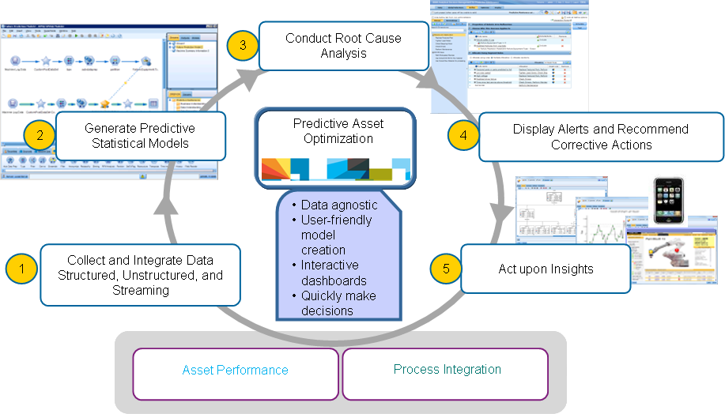
Predictive Optimization Analytics (POA)
Monitor, maintain, and optimize assets for greater operations efficiency
Updated xx-xx-12
NEW
What’s New (or New Enhancement/ Business Value)
An enhanced advanced analytics methodology, tailored to the needs of the predictive asset or maintenance space
Predictive Asset Optimization converged with IBM’s Enterprise Asset Management and Analytics capabilities.
Out of the box or Cloud solution with pre-integrated software tools enabling IBM customers to achieve faster time to value
Enables its customers to predict part quality, which will help improve customer service and the customer experience.
Key Differentiators
Predictive models for a number of specific industry use cases
An enhanced advanced analytics methodology, tailored to the needs of the predictive asset or maintenance space
Pre-configured dashboard and visualization templates
Pre-integrated software tools, with connectors to a variety of asset management solutions
A resource pool of highly talented analytic Subject Matter Experts and Industry experts with predictive asset optimization experience.
Client Benefits
Gain visibility into asset health, Lower costs of unscheduled maintenance, Accurately forecast downtime and costs
Separate the ‘signals’ from the ‘noise’, Gain visibility of predictors across organizational silos, Leverage analytical insights for asset optimization
BMW - Reduced warranty costs by 5%, Repeat repairs by 50%
Notes:
SPEAKER NOTES PRESENTERS may want to delete speaker notes prior to presenting to clients/external audience
Offering Name:
Offering Description:
Target Market/Industries
What is New News?
Client Needs Addressed:
bullet
bullet
Value Proposition: (Describe how the offering helps the consumer improve operations, deliver/access new capabilities, increase revenues/profits, perform roles more efficiently, perform functions previously not possible )
bullet
bullet
bullet
Key Benefits: (for Launch Theme)
bullet
bullet
Competitors & Differentiation: (List appropriate competitors and key differentiation from IBM vs. Competitors)
bullet
bullet
Sparklers: (Measurable or significant performance/capability facts or proof points)
bullet
bullet

Slide 48
Next Best Action (NBA)
Updated xx-xx-12
Brand / BU | GBS
Announcement Date
eGA Date
Offering Type | Cloud Solution
RFA #
Offering Manager
Marketing Manager
Demand Programs Supported | Cloud & Smarter Infrastructure Asset & Facilities Management Campaign
Sales Kit / Play | <links go here>
PartnerWorld Sales Kit / Play | <links go here>
IBM.com link | <links go here>
Promotional Offers | <links go here>
Offering Overview with Value Proposition | IBM’s Next Best Action Solution drives analytics management, and real-time decisioning. it Maximizes strategic lifetime value, profitability and loyalty with imporoved service and customer satisfaction, Increases revenue by up sell, cross sell & retention . accelerates time to value. Solution entry points include a Digital Front Office Strategy, 360 degree view of customer, campaign management project, or a customer analytics pilot.
Client Needs Addressed | NBA’s reward-driven, micro-segmentation approach unlocks the unique triggers of each customer and generates the most appropriate action, optimized for business constraints. In addition, the solution delivers proven outcomes through a rich portfolio of IBM’s analytics capabilities spanning services, software, and research.
What’s New | Cloud-enabled asset: The NBA Optimizer asset provides access to patented, leading edge algorithms for recommending actions that maximize customer life time value. It performs dynamic segmentation and provides recommended actions based on key constraints. The NBA Optimizer asset accelerates time to value with limited upfront investment. The asset runs on an IBM SoftLayer SmartCloud in a private cloud configuration. It is available for projects in a subscription-based model.
Bundle Components | Infosphere, Netezza, Cognos, SPSS, Unica
Target Market | Telco, Banking, Insurance, Life Sciences
Target Audience/ Roles | CEO, CMO, VP of Marketing
What Non-IBM Offerings Does This Product Compete With? | Oracle, SaS, SAP, Pega with Chordiant, Teradata, TIBCO, FICO Differentiators: BAO vision leadership; Insight, Vision, and Industry-recognized Consulting Full solution capability; across all channels Strong coverage of full analytic and foundational capabilities (Information Management, Predictive Analytics, Business Rules, and more) Advanced Analytics, Decision Management, Cross Channel Real Time Action, IBM Big, Data PlatformMultiple Entry Points
RTM (Identify OI & OO) | <Market>: <Channel>
Countries Available | Worldwide
Purchasing | <link to purchase site goes here>
Technical Support Structure | Read about the Electronic Support portfolio of tools : http://ibm.com/electronicsupport Access the IBM Support Portal : http://ibm.com/support Access the online Service Request tool: http://ibm.com/support/servicerequest
For Cloud Only
Cloud Category: Think it, Build it, Tap Into it | Build it, Tap into it
Cloud Type: Private Public Both or Hybrid | Private
Category: IaaS, SaaS, PaaS, BPaaS | PaaS, SaaS
Notes:
48

Slide 49
Next Best Action (NBA)
Linking data, to analysis, to decisions deployed at the point of contact
Updated xx-xx-12
NEW
What’s New (or New Enhancement/ Business Value)
Cloud enabled NBA Optimizer performs dynamic segmentation and provides recommended actions based on key constraints as a service. The asset runs on an IBM SoftLayer SmartCloud in a private cloud configuration. It is available for projects in a subscription-based model.
Information Integration – High performance integration on a large volume of information for data warehouses, Hadoop systems, streaming information sources, and transactional systems. Data transformation and remediation to ensure the appropriate level of quality massive volume and scale (terabytes per second).
Key Differentiators
BAO vision leadership; Insight, Vision, and Industry-recognized Consulting
Full solution capability; across all channels
Strong coverage of full analytic and foundational capabilities (Information Management, Predictive Analytics, Business Rules, and more)
Client Benefits
Improve service delivery and customer satisfaction
Optimize revenue generating actions such as up sell, cross sell and retention
Increase strategic lifetime value and loyalty
It accelerates time to value with limited upfront investment.
First Tennessee Bank - Delivered 600% ROI “Our aim was to shift from the ‘marketing as an expense’ mindset to the idea that marketing is a true profit driver.”
Dan Marks, CMO
Notes:
SPEAKER NOTES PRESENTERS may want to delete speaker notes prior to presenting to clients/external audience
Offering Name:
Offering Description:
Target Market/Industries
What is New News?
Client Needs Addressed:
bullet
bullet
Value Proposition: (Describe how the offering helps the consumer improve operations, deliver/access new capabilities, increase revenues/profits, perform roles more efficiently, perform functions previously not possible )
bullet
bullet
bullet
Key Benefits: (for Launch Theme)
bullet
bullet
Competitors & Differentiation: (List appropriate competitors and key differentiation from IBM vs. Competitors)
bullet
bullet
Sparklers: (Measurable or significant performance/capability facts or proof points)
bullet
bullet

Slide 50
Fraud and Abuse Management System (FAMS)
Updated xx-xx-12
Brand / BU | GBS
Announcement Date
eGA Date
Offering Type | Cloud Solution
RFA #
Offering Manager
Marketing Manager
Demand Programs Supported | Cloud & Smarter Infrastructure Asset & Facilities Management Campaign
Sales Kit / Play | <links go here>
PartnerWorld Sales Kit / Play | <links go here>
IBM.com link | <links go here>
Promotional Offers | <links go here>
Offering Overview with Value Proposition | The Counter-Fraud and Financial Crimes offering provides a layered approach to disrupt the intentions of both organized and opportunistic fraudsters. FAMS will Identify potential fraud before payment, reducing expensive recovery actions, Detect multiple behaviors and schemes simultaneously, Analyze claim and provider level information to detect suspicious patterns, and Provide evidence-based identification of target cases for investigation. The solution consists of proven GBS accelerators and assets supported by IBM software and technology
Client Needs Addressed | The Counter-Fraud and Financial Crimes offering represents proven innovation implemented at clients worldwide, and brings the best of IBM capabilities together. IBM’s research, technology, and expertise helps companies discover fraud scientifically, and pursue cases faster and more cost-effectively.
What’s New | Cloud-enabled asset: Fraud & Abuse Management System (FAMS) Asset enabled is available in a cloud environment for retrospective Business Controls fraud discovery in Time & Expenses and Accounts Payables. IBM services help configure and operate the solution, perform data loads, and generate profile models for customer analysis. This runs on on IBM SoftLayer
Bundle Components | Infosphere, Netezza, Cognos, SPSS, Unica, WebSphere, ILOG BRMS, Identity Insight,FileNet
Target Market (Incl industries) | Healthcare Payer, Government (Medicaid, Medicare, Workers Compensation), Banking, Warranty, Insurance, Energy & Utilities, Workers Compensation, Taxation, Travel
Target Audience/ Roles | CFO; Risk Manager, Head of Special Investigations Unit; Program Integrity coordinator
What Non-IBM Offerings Does This Product Compete With? | Differentiators: Uses advanced analytics and statistics, not queries Contains pre-built behavior models that can be adapted in hours for a payer organization Powerful analytics are presented in easy-to-understand format for investigators Unlike many competing solutions, FAMS does not require users to have advanced degree in statistics
RTM (Identify OI & OO) | <Market>: <Channel>
Countries Available | Worldwide
Purchasing | <link to purchase site goes here>
Technical Support Structure | Read about the Electronic Support portfolio of tools : http://ibm.com/electronicsupport Access the IBM Support Portal : http://ibm.com/support Access the online Service Request tool: http://ibm.com/support/servicerequest
Cloud Category: Think it, Build it, Tap Into it | Tap into it
Cloud Type: Private Public Both or Hybrid | Private
Category: IaaS, SaaS, PaaS, BPaaS | SaaS
Notes:
50

Slide 51
Fraud and Abuse Management System
Clients detect, prevent, investigate, and discover fraudulent behavior
Updated xx-xx-12
NEW
What’s New (or New Enhancement/ Business Value)
Cloud-enabled asset: Fraud & Abuse Management System (FAMS) Asset enabled is available in a cloud environment for retrospective Business Controls fraud discovery in Time & Expenses and Accounts Payables. IBM services help configure and operate the solution, perform data loads, and generate profile models for customer analysis.
The FAMS for Business Controls asset runs on an IBM SoftLayer SmartCloud. It is a private Cloud configuration, accessible by a client for analysis and reports through a secure web browser connection
Key Differentiators
Uses advanced analytics and statistics, not queries
Contains pre-built behavior models that can be adapted in hours for a payer organization
Powerful analytics are presented in easy-to-understand format for investigators
Unlike many competing solutions, FAMS does not require users to have advanced degree in statistics
Client Benefits
Identify potential fraud before payment, reducing expensive recovery actions
Detect multiple behaviors and schemes simultaneously
Analyze claim and provider level information to detect suspicious patterns
Provide evidence-based identification of target cases for investigation
Humana reported a 30% - 40% reduction in cycle time for identification and verification of questionable claims
Notes:
SPEAKER NOTES PRESENTERS may want to delete speaker notes prior to presenting to clients/external audience
Offering Name:
Offering Description:
Target Market/Industries
What is New News?
Client Needs Addressed:
bullet
bullet
Value Proposition: (Describe how the offering helps the consumer improve operations, deliver/access new capabilities, increase revenues/profits, perform roles more efficiently, perform functions previously not possible )
bullet
bullet
bullet
Key Benefits: (for Launch Theme)
bullet
bullet
Competitors & Differentiation: (List appropriate competitors and key differentiation from IBM vs. Competitors)
bullet
bullet
Sparklers: (Measurable or significant performance/capability facts or proof points)
bullet
bullet

Slide 52
Customer Master Data Management (MDM)
Updated xx-xx-12
Brand / BU | GBS
Announcement Date
eGA Date
Offering Type | Cloud Solution
RFA #
Offering Manager
Marketing Manager
Demand Programs Supported | Cloud & Smarter Infrastructure Asset & Facilities Management Campaign
Sales Kit / Play | <links go here>
PartnerWorld Sales Kit / Play | <links go here>
IBM.com link | <links go here>
Promotional Offers | <links go here>
Offering Overview with Value Proposition | IBM Customer MDM is a feature-rich recommender system developed to generate explicit customer profiles, boost sales and provide a rich infrastructure for advertisement targeting. It takes business data related to customers and analyzes the behavioral data and enables new insights and business scenarios based on analysis of relationships among customers and content and relationships of customers among themselves. MDM gathers customer information from various sources to build rich customer profiles. Information sources include products, warehouse inventory, behavioral data from web searching and browsing, blogs and Twitter, location and time information and other sources such as products browsed or purchased, product catalogs, web site metadata, public sources, IMDB and others. MDM supports multiple usage scenarios, including analyzing behavior to tune product and service offerings; optimizing advertising by predicting customer demographics; and optimizing marketing by understanding customer interests. Customer MDM supports new products launches, customer acquisitions and advertisement campaign management.
Client Needs Addressed | Customer Marketing MDM Provides an analysis framework to: Analyze interactions with a customer through all channels, Build a model of the customer representing his/her behavior and preferences, Build a model of the products representing the segment of customers consuming them, It is symmetric: it can recommend products for customers and customers for products (targeting), Helps determine what is appropriate for this (type of) customer?, Helps determine who to promote this (type of) service/product/content to?
What’s New | Cloud-enabled asset: The asset runs on the IBM SmartCloud in a private cloud configuration. It is available for projects in a subscription-based model.
Bundle Components | InfoSphere, Netezza, Cognos, ODS, MDM Server
Target Market | All industries
Target Audience/ Roles | CEO, CMO, CFOs, CEO, VP of Marketing, VPs of Products
What Non-IBM Offerings Does This Product Compete With? | Oracle, SaS, SAP, Pega with Chordiant, Teradata, TIBCO, FICO Differentiators: It improves marketing by understanding customer interests as expressed in social media and other data sources, it can recommend products for customers and customers for products, Exploits rich information about customers and products, Supports all scenarios: new customers, new products, customer context, product categories , Dynamically combines popularity, products associations, collaborative and social recommendations for optimized results, Directly generates recommendations that can be accessed through the system API or the Marketing and Targeting GUI
RTM (Identify OI & OO) | <Market>: <Channel>
Countries Available | Large global organizations, existing GBS, SWG presence, Core and Invest Accounts
Purchasing | <link to purchase site goes here>
Technical Support Structure | Read about the Electronic Support portfolio of tools : http://ibm.com/electronicsupport Access the IBM Support Portal : http://ibm.com/support Access the online Service Request tool: http://ibm.com/support/servicerequest
Cloud Category: Think it, Build it, Tap Into it | Build it, Tap into it
Cloud Type: Private Public Both or Hybrid | Private
Category: IaaS, SaaS, PaaS, BPaaS | PaaS, SaaS
Notes:
52

Slide 53
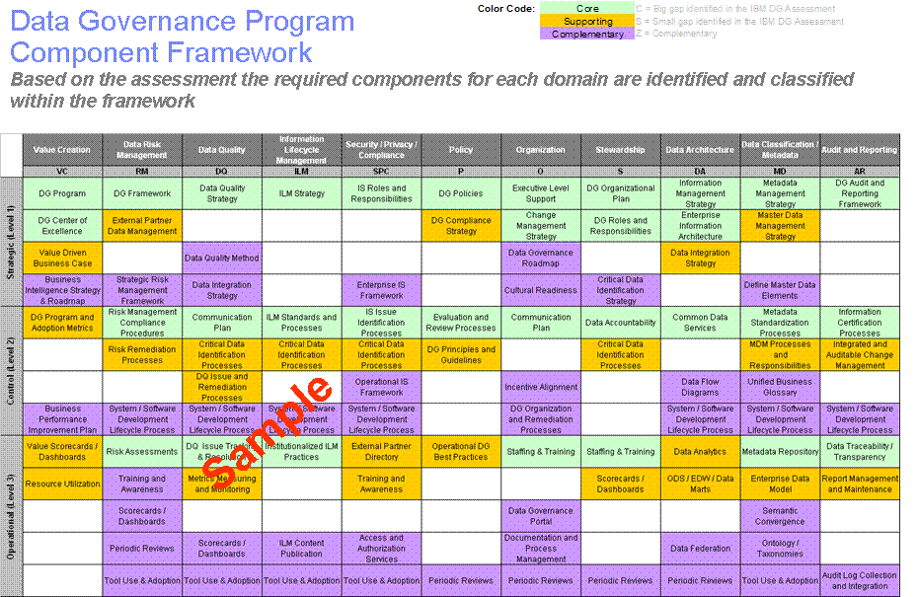
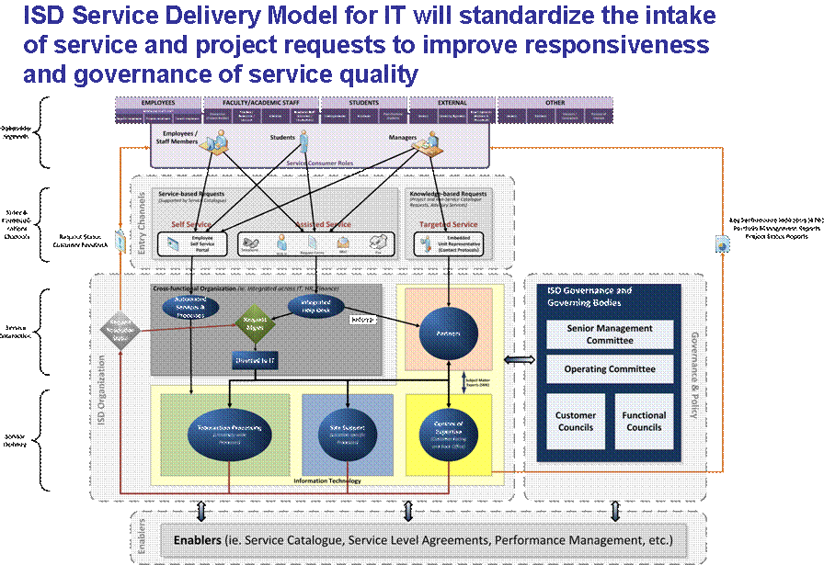
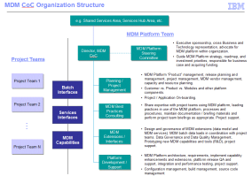
Customer Master Data Management (MDM)
Customer focus insight driven analytics prescriptive action
Updated xx-xx-12
NEW
What’s New (or New Enhancement/ Business Value)
The asset runs on the IBM SmartCloud in a private cloud configuration. It is available for projects in a subscription-based model.
Out of the box or Cloud solution with pre-integrated software tools enabling IBM customers to achieve faster time to value
Key Differentiators
.IBM MDM implementation allows us to design a solution that compliments MDM rather than conflicts with MDM – this applies from both real time services as well as batch interfaces
IBM’s reputation and proven track record in marketing analytics.
Client Benefits
Modern highly flexible \ extensible architecture (J2EE, SOA)
Provides a framework to re-architect and simplify interface and integration patterns
Delivers capability beyond what CIS offers today (e.g. enhanced customer search and matching capabilities, improved data quality)
Will enable support for other business and regulatory requirements (e.g. Commercial CIF, Creditor Insurance, STEP, FATCA, Name Scanning, Paperless, CIM)
Channel integration, cost savings in right-channeling
Notes:
SPEAKER NOTES PRESENTERS may want to delete speaker notes prior to presenting to clients/external audience
Offering Name:
Offering Description:
Target Market/Industries
What is New News?
Client Needs Addressed:
bullet
bullet
Value Proposition: (Describe how the offering helps the consumer improve operations, deliver/access new capabilities, increase revenues/profits, perform roles more efficiently, perform functions previously not possible )
bullet
bullet
bullet
Key Benefits: (for Launch Theme)
bullet
bullet
Competitors & Differentiation: (List appropriate competitors and key differentiation from IBM vs. Competitors)
bullet
bullet
Sparklers: (Measurable or significant performance/capability facts or proof points)
bullet
bullet

Slide 54
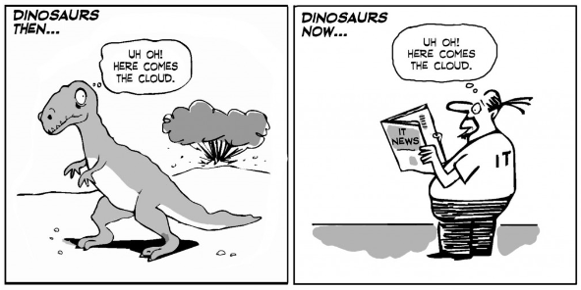
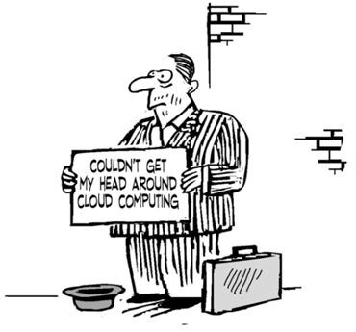

Slide 55
Q&A

Slide 56
Backups

Slide 57
Advisory offering and BVA
PRACTICE | OFFERINGS | DESCRIPTION | RESOURCES | SMEs
Advisory | BVA – Cloud-Enabled Business Models | Technological shifts have dramatically altered traditional value chains, straining the capabilities of existing business models. Business is at an inflection point where business models are constrained by limitations on computing and analytics power. Cloud is at a tipping point, as broadband was a few years ago -- the increasing ubiquity of unlimited computing capacity has the power to change not only how, but what business is conducted. Cloud drives business model innovation by enabling targeted, rapid prototyping, redesign and redeployment of new models; facilitates the rapid analysis of massive and unstructured data sets; increases the network for collaboration and innovation and provides the flexibility to scale up to unlimited processing power or down to suit more regular needs - all with variable pricing and enhanced security. | BVA - Cloud Enabled Business Model Accelerator Cloud Enabled Business Model Education Cloud Strategy Wiki Cloud Strategy Framework Overview | Mike Fitzgerald Anthony Karimi Matt Porta Carsten Meinecke Eiri Ishida Mac McIntosh
Advisory | Cloud Strategy Framework | The strategy framework offering is organized around four key dimensions for cloud adoption: Business Models: Impact of cloud on business processes, GTM channel, revenue generating strategy and such. Enables industry, enterprise and business unit initiatives to drive step-change market performance. Application and Delivery Platforms: Cloud based environment for fast development and deployment. Helps CIOs develop a competitive software delivery strategy. Leverages variable service models for application software to enhance process agility and economics. Data Platforms: Methods to increase business intelligence. Use analytics in decision making, anticipate the next best action a company can respond to market activities. Leverages variable service models to align enterprise capabilities in data transformation and management. Infrastructure Platforms: Infrastructure strategy designed to help client investigate their cloud implementation options in detail. IT and technology focus discussion. Evaluate the current environment and identify IT enhancement needed to achieve business objectives. | Cloud Strategy Wiki Cloud Strategy Framework Overview | Mike Fitzgerald Anthony Karimi Matt Porta Carsten Meinecke Thomas Guinan
Notes:
57
Resources and SME columns - Explain the links in this section and when viewed in slide show go directly into the Solution Gateway or to the SME’s contact information for quick reference. Notice that if the offering is a BVA the title will call that out.

Slide 58
Application Services: AMS Offerings
PRACTICE | OFFERINGS | DESCRIPTION | RESOURCES | SMEs
Application Services | Cloud Application Migration | Migration Services for Cloud (MCloud) is a service designed to assist clients with the migration of their application portfolio to a Cloud environment of their choice. Supports IBM Cloud solutions, private Cloud on premise, and hosted private, public or mixed Cloud environments. Part of the services offered with SmartCloud Enterprise +, the complete package of infrastructure and application services. Cost-effective and low risk plan for the migration of workloads to the new platform, enabling clients to quickly realize the benefits of a Cloud environment. | Migration Services for Cloud | Claudio Cozzi (Business Owner) Kevin Galloway (Offering Owner) Corey Allen (Sales and Delivery) Erick Perales (Sr. Architect)
Application Services | Cloud Testing Services – Performance Testing | Testing Services for Cloud–Performance Testing : Cloud based Performance Testing delivers a highly scalable, automated and cost effective approach to performance testing An entry point to Integrated Development and Test Environment, Testing Services for Cloud - performance testing, provides performance testing services that leverage various Cloud models based on clients need. | Testing Services for Cloud – Performance Testing | Kazuaki Matsutani Thomas Winkeler ChaeHyung Kweon
Application Services | Cloud Testing Services – Application Virtualization | Testing Service for Cloud–Application Virtualization: Cloud based Application Virtualization Services delivers simulated development and test environments at a fraction of the cost of typical test environments. An entry point to Integrated Development and Test Environment, Testing Services for Cloud - application virtualization, provides application virtualization services that leverage various Cloud models based on clients need. | Testing Services for Cloud – App Virtualization | Kazuaki Matsutani Thomas Winkeler ChaeHyung Kweon
Notes:
Resources and SME columns - Explain the links in this section and when viewed in slide show go directly into the Solution Gateway or to the SME’s contact information for quick reference. Notice that if the offering is a BVA the title will call that out.

Slide 59
Application Services: AMS BVA’s
PRACTICE | OFFERINGS | DESCRIPTION | RESOURCES | SMEs
Application Services | Cloud Application Virtualization | Application Virtualization Services (AVS) is focused on helping clients by virtualizing IT resources to provide on-demand accessibility and capacity for teams across the entire software life cycle. The Cloud Application Virtualization is a two week engagement that demonstrates the benefits of Application Virtualization by virtualizing a set of client applications and assessing the ability to optimize computing resources and simplify existing test management infrastructure. | BVA – Cloud Application Virtualization | Kazuaki Matsutani Thomas Winkeler ChaeHyung Kweon
Application Services | Cloud Migration Rapid Assessment (CMRA) | The Cloud Migration Rapid Assessment (CMRA) helps clients assess the opportunity to migrate all or part of their source environment to the Cloud environment of choice. This migration plan may identify additional modernization services that are needed to support the migration efforts. In the assessment, Cloud experts assess the opportunity and benefits for migrating applications in the client’s portfolio to the new environment with a minimum set of data from the source and target environments. Using actual workload information obtained with automated tools and profile templates, the existing environment is mapped to the target Cloud platform. This process results in a clear and accurate roadmap for migration acceleration. | BVA - (CMRA) Cloud Migration Rapid Assessment | Claudio Cozzi (Business Owner) Kevin Galloway (Offering Owner) Corey Allen (Sales & Delivery) Erick Perales (Sr. Architect)
Notes:
Resources and SME columns - Explain the links in this section and when viewed in slide show go directly into the Solution Gateway or to the SME’s contact information for quick reference. Notice that if the offering is a BVA the title will call that out.

Slide 60
Application Services: AIS Offerings
PRACTICE | OFFERINGS | DESCRIPTION | RESOURCES | SMEs
Application Services | Mobile Innovation in the Cloud | Mobile Innovation in the Cloud is the first fully structured cloud ‘outcomes based model’ in the market to meet the mobile solutions demands Mobile Innovation in the Cloud is GBS / AIS led, xBrand offering for the delivery of applications on smart devices. The offering includes a menu of deliverables with fixed prices, including UI designs, port of code between platforms, new application development and maintenance. | Mobile Application Development from the Cloud | Blaine Dolph Mark Nielson
Application Services | Cloud Application Modernization | AIS / AMS Cloud Application Modernization Offering: Application modernization efforts involves capabilities for a factory model for migration of applications to Cloud and modernization of applications using API-centric solutions An analytical approach to decide on “cloudability” and “API”s for modernization of applications: Migrate / Transform / Rebuild |  | Ram Ravishankar Mark Bearden
Application Services | Cloud ADaaS (Application Development as a Service) | ADaaS is a GBS / AIS Cloud Offering to meet the growing demands of our clients. A cloud-based Dev / Test / Prod environment that can be quickly spun up for IBM internal, as well as client access |  | John DeMarco
Application Services | Cloud API Architecture and Roadmap | The API Centric Architecture and Roadmap offering is a prescriptive analysis for both Business and IT It guides and helps determine the architecture and roadmap for an API Centric Architecture |  | Sham Vaidya
Notes:
Resources and SME columns - Explain the links in this section and when viewed in slide show go directly into the Solution Gateway or to the SME’s contact information for quick reference. Notice that if the offering is a BVA the title will call that out.

Slide 61
SAP Offerings
PRACTICE | OFFERINGS | DESCRIPTION | RESOURCES | SMEs
SAP | SAP SmartCloud Express | SAP Subscription based Hosting: SAP Express Industry Solutions using a subscription-based Hosting model allows for a ‘pay as you go’ option ,on a per user / per month basis IBM’s SAP Express Industry Solutions will be offered via a Subscription based Hosting model as fixed monthly payments from 2 - 5 year contracts comprised of SAP licensing, ongoing software maintenance, application maintenance, hosting, OS and DB support and TSAM auto-provisioning. These services included in the offering lead to a reduced implementation timeline. GB will leverage the existing GTS Cloud architecture and the Express Industry Solutions for the offering. Customers will use a Web portal to access a self-service catalog containing Express Industry Solution images available for auto-provisioning. Initial Industry Solutions available in the catalog include the Dairy solution in India, Solar in Germany, and Trade Promotions. The offering includes the following capabilities: Pre- Packaged SAP Industry vertical solution: The IBM SbH solutions bundle SAP resell software, GBS industry solutions ,ongoing software maintenance, application maintenance, hosting, OS and DB support, and TSAM auto-provisioning. Accelerators included with the solution are documentation, tools, and content to support comprehensive scope and accelerated timeline. Industry Vertical business process : SAP ERP solutions provide a full range of integrated business processes at the micro- niche vertical level. | SAP Subscription based Hosting | Chuck Kichler Tom Pavsic Paul Tennyson Mark Dudgeon Takeshi Tone
SAP | SAP SaaS SAP LCaaS | SAP additional resources SAP SmartCloud is an enterprise-class fully managed PaaS (platform as a service) to run SAP production environments LCaaS is a holistic offering that provides rapid implementation from day one of the project in a safe, secure, dynamic, and shared or private hosted Cloud environment that can expand to support all non-production and production environments with both technical and functional support at predictable and cost-effective rates. | SAP Cloud Wiki Lifecycle as a Service Examples and Timelines SAP Practice Cloud Strategy Launching SmartCloud for SAP | Chuck Kichler Tom Pavsic Paul Tennyson Mark Dudgeon Takeshi Tone
Notes:
Resources and SME columns - Explain the links in this section and when viewed in slide show go directly into the Solution Gateway or to the SME’s contact information for quick reference. Notice that if the offering is a BVA the title will call that out.

Slide 62
ISV: Salesforce.com
PRACTICE | OFFERINGS | DESCRIPTION | RESOURCES | SMEs
Salesforce.com | Front Office Transformation and implementation services Service Cloud Sales Cloud Marketing Cloud PaaS (Force.com) Enterprise Salesforce.com strategic roadmap and Governance Enterprise Cloud Integration Strategy and Implementation Customer Focused Cloud Strategy | Overview – Salesforce.com is currently the leader in Cloud-enabled CRM with competition getting stronger. IBM established a partnership with salesforce.com to leapfrog into the CRM Cloud services space. IBM is a premier Global System Integrator (GSI) for salesforce.com. Market Insight Salesforce.com is Gartner’s # 1 rated sales force automation tool IBM is Gartner’s #1 rated CRM services practice. IBM Differentiators Leading Global CRM Practice Business Strategy and Value Realization Core Consulting through Implementation, Support, Outsourcing IBM Cloud Integration and Analytics software portfolio Enterprise Global Delivery Global sourcing model driving quality, efficiency and results Proven global governance model for long term support Large scale, enterprise implementation, integration and enablement Over 250 plus projects, over 130 Salesforce.com resources Have Salesforce.com Center of Competency in India We have software assts, such as Cast Iron® and capability to outsource business processes on a large scale | GBS Salesforce.com Global Community GBS Salesforce.com AMEX Community IBM Salesforce.com Competitive Community | Daniel Delos Bevin Arnason Jos Kuijer Melveer Blah
Notes:
Resources and SME columns - Explain the links in this section and when viewed in slide show, go directly into the Solution Gateway or to the SME’s contact information for quick reference. Notice that if the offering is a BVA the title will call that out.

Slide 63
ISV: Workday Offerings
PRACTICE | OFFERINGS | DESCRIPTION | RESOURCES | SMEs
Workday | Advisory–Customer cloud strategy, Package selection, On-premise vs. SaaS assessment, Human Capital Management Transformation, Finance Transformation Implementation–HCM, Financials, Payroll, CastIron Maintenance–Standard GD support model with Workday skills | Overview Workday is the leader in cloud-based enterprise applications that combine a lower cost of ownership with an innovative approach for global businesses. Founded by PeopleSoft veterans Dave Duffield and Aneel Bhusri, Workday provides unified Financial Management and Human Capital Management applications designed for today’s organizations and the way people work. Delivered in the cloud and leveraging a modern technology platform, Workday offers a fresh alternative to traditional solutions provided as Software as a Service (SaaS). Market Insight Forrester Wave positions Workday as an HRMS leader, along with Oracle and SAP IDC, Forrester and Gartner predict that Workday will be #3 in market share for Enterprise HRIS in five years – May 2012 Workday Differentiators Built from the Cloud Up: Designed as a SaaS, Cloud based solution from its inception Real Cloud: One line of code and always up to date; Single version of Workday exists across all customers Mobile: Workday mobile apps available for use with iPhone and iPad (native support), as well as all other devices using HTML5 (mobile web support) Global: Ability to manage talent, revenue, cost, and growth around the globe from a single source Actionable Insight: Obtain data, analyze information, and take action in real time Agility: Workday is configurable to meet the needs of an organization Security: Workday takes a holistic approach to security, ranging from technical safety guards to understanding data privacy laws and compliance Integration: Every customer and partner in the Workday ecosystem gets access to a proven set of tools to build and deploy integrations IBM Differentiators Enterprise Solutions: Global end-to-end HCM and Finance Transformation capabilities, including Change Management, as well as AMS and BPO offerings IBM Global Financing: Supporting clients with transitioning from a Capital Expenditure to Operating Expenditure model IBM Software: Surrounding Workday with our software portfolio is a unique differentiator. Kenexa, CastIron, and so on | GBS Workday Global Community Workday Wiki | Gary Hill Mark Nichols Ken Fontenot Daniel Miller Paige Bayliss Andy Malay
Notes:
Resources and SME columns - Explain the links in this section and when viewed in slide show go directly into the Solution Gateway or to the SME’s contact information for quick reference. Notice that if the offering is a BVA the title will call that out.

Slide 64
ISV: MS Dynamics Offerings and BVA
PRACTICE | OFFERINGS | DESCRIPTION | RESOURCES | SMEs
MS Dynamics | Microsoft Dynamics AX Microsoft Dynamics CRM Microsoft Dynamics AMS BVA - Microsoft Dynamics ERP Assessment | Microsoft Dynamics AX -Microsoft Dynamics AX (Axapta) ERP solution provides organizations a purpose-built foundation across industries, along with comprehensive, core ERP functionality for financial, human resources and operations management. IBM provides consulting and implementation services for Microsoft Dynamics AX, a comprehensive ERP solution for midsize and Enterprise organizations that empowers people to work effectively, manage change, and compete globally. Microsoft Dynamics CRM - Microsoft Dynamics CRM is a highly flexible customer relationship management (CRM) platform that can adapt, grow, and scale with your business. IBM provides consulting and implementation services for Microsoft Dynamics CRM solution, a fully integrated CRM system, which gives organizations the capability to easily create and maintain a clear view of their customers from first contact through purchase and post-sales. Microsoft Dynamics AMS - IBM provides Application Management Services (AMS) for Microsoft applications such as Dynamics AX, Dynamics CRM, SharePoint, and BizTalk. IBM AMS ensures the applications are optimized, responsive, and available to users when they need them. IBM Application Services can supplement client staff, co-manage applications, or even manage entire set of applications. Microsoft Dynamics ERP Assessment - With the Microsoft Dynamics ERP Assessment, we create a strategic approach for developing an ERP strategy that integrates business, user, and IT requirements and includes recommendations for ERP architecture, application development, and maintenance, as well as an implementation roadmap aligned to Microsoft Dynamics. IBM Differentiators: - IBM Microsoft practice has been a member of the Microsoft Certified Partner program since 1995 and is today is one of the largest globally managed Microsoft Gold Certified Partner. - IBM has over 5,000 fully dedicated staff globally with an average of 7+ years of Microsoft technology experience with 75% Microsoft Certification holders. - Capabilities in Large enterprise scale engagements requiring custom application development with complex system integration requirements. Our solutions include the entire suite of Microsoft products and technologies - Leading firm involved in joint development with Microsoft on .NET industry based standards and high-end clustering solutions at the IBM Kirkland Lab. | Microsoft Dynamics AX Microsoft Dynamics CRM Microsoft Dynamics AMS BVA - Microsoft Dynamics ERP Assessment GBS General Business Microsoft Community GBS Global General Business wiki | Kathy Piontek Jim Redman Iain Fox Michel Leblanc Amitaya Bose Luis Gallardo Cliff Howard
Notes:
Resources and SME columns - Explain the links in this section and when viewed in slide show go directly into the Solution Gateway or to the SME’s contact information for quick reference. Notice that if the offering is a BVA the title will call that out.

Slide 65
Mobile BVA’s
PRACTICE | OFFERINGS | DESCRIPTION | RESOURCES | SMEs
Mobile | BVA - Mobile Strategy Accelerator | The Mobile Strategy Accelerator is a focused, yet flexible offering that is intended to help clients understand how to most effectively integrate the unique capabilities offered by mobile devices into their business. This approach is designed to develop an enterprise level mobile business vision and supporting rationale as well as a portfolio of mobile capabilities and applications. The strategy is balanced by tactical recommendations addressing device/platform type, as well as infrastructure and integration requirements. The result is an actionable roadmap that optimizes mobile opportunities and accelerates time to market. | Mobile Strategy Accelerator | Kevin Custis Mark Nielsen Michael Brettner Hiroyuki Iizuka
Mobile | BVA - Omni-Channel Customer Experience Assessment | In this accelerator, we help our clients assess and re-envision their digital presence across all touch points, including physical / store, web, mobile, and social. We facilitate intensive workshops, which include the use of our Customer Journey Mapping tools for visualizing how customers interact across channels. We also use our Channel Capabilities Maturity (CCM) Framework, which provides a structured way to rapidly analyze current and future capabilities across seven different channel competencies. The result is a plan for building a new digital presence that will provide a consistent, more personalized, and more impactful experience across touch-points. | Omni- Channel Customer Experience Assessment | Kevin Custis Mark Nielsen Michael Brettner Hiroyuki Iizuka
Mobile |  | Seller Education | Mobile Cloud (GBS Seller Education) | Kevin Custis Mark Nielsen Michael Brettner Hiroyuki Iizuka
Notes:
Resources and SME columns - Explain the links in this section and when viewed in slide show go directly into the Solution Gateway or to the SME’s contact information for quick reference. Notice that if the offering is a BVA the title will call that out.

Slide 66
SWG SaaS Offerings
PRACTICE | OFFERINGS | DESCRIPTION | RESOURCES | SMEs
SWG SaaS | Smarter Buildings | To learn more about the Signature Solutions contact the SME’s listed. | Smarter Buildings | James M. Caton
SWG SaaS | Maximo | To learn more about the Signature Solutions contact the SME’s listed. | Maximo | Joel McGlynn
SWG SaaS | Smarter Commerce, BPM, Analytics | IBM Commerce on Cloud enables companies to quickly upgrade their e-Commerce capabilities to deliver a seamless, end-to-end customer experience. Benefits Enhance the customer experience by providing buyers with visibility into product availability, order history and order status information. Empower your business to create relationships with customers and personalize the shopping experience through precision marketing. Minimize buyer’s remorse and accelerate the purchase to delivery process with flexible fulfillment options. Ensure your business is positioned for success with the ability to change easily between cloud-based and on-premise solutions. What's new ? IBM Commerce on Cloud offers the advantages of cloud economics and immediate access to Smarter Commerce™ solutions in order to accelerate your company’s ability to transform the entire customer experience. | IBM Commerce on the Cloud IBM Commerce on the Cloud (GBS Seller Education) | Steve Laughlin Adam Steinberg Juanita Engen John Simone
Notes:
Resources and SME columns - Explain the links in this section and when viewed in slide show go directly into the Solution Gateway or to the SME’s contact information for quick reference. Notice that if the offering is a BVA the title will call that out.

Slide 67
Industry Solutions
PRACTICE | OFFERINGS | DESCRIPTION | RESOURCES | SMEs
Industry Solutions | PAO (Predictive Asset Optimization) | IBM Signature Solution - predictive asset optimization (PAO) 1. Anticipate asset failure before issues occur and improve overall operational efficiency 2. Maximizes operational performance and optimizes associated processes to drive enterprise-wide efficiencies and profitability. 3. PAO enables users to perform two business critical tasks: a) Maintain, monitor and optimize production assets for better availability, utilization and performance, and b) Predict asset failure to optimize quality and supply chain processes. Target Industries – Aerospace and Defense, Automotive, Electronics, Chemical & Petroleum, Mining, Energy and Utilities, Telecommunications | PAO | Pierre Haren
Industry Solutions | NBA (Next Best Action) | IBM Signature Solution - next best action delivers the most appropriate action at the right time through any channel. Personalized interactions are enabled by: Comprehensive view of a customer Real-time predictive analytics to anticipate customer behavior, preferences and attitudes Cross-channel delivery of best action to address customer need and enhance long term business revenue Next Best Action allows clients to make informed decisions and drive the best possible outcome on each individual interaction in order to maximize customer profitability. Target Industries – Telco, Banking/FM, Insurance | NBA | Pierre Haren
Notes:
Resources and SME columns - Explain the links in this section and when viewed in slide show go directly into the Solution Gateway or to the SME’s contact information for quick reference. Notice that if the offering is a BVA the title will call that out.

Slide 68
S&A Offerings
PRACTICE | OFFERINGS | DESCRIPTION | RESOURCES | SMEs
S&A | FAMS (Anti-fraud, Waster, & Abuse) | FAMS - Uses advanced analytics to detect fraud and abuse. The solution contains pre-built fraud detection models that can be used to accelerate time-to-value. FAMS can be used to detect suspicious behaviors before money is paid (near real-time) or retrospectively. | FAMS | Rick Hoehne
S&A | BAO Jumpstart | To learn more about BAO Jumpstart click on the resources link or Contact SME listed. | BAO Jumpstart | Monica Logan
S&A | Cloud enabled Signature Solutions | To learn more about the Signature Solutions contact the SME’s listed. |  | Monica Logan
Notes:
Resources and SME columns - Explain the links in this section and when viewed in slide show go directly into the Solution Gateway or to the SME’s contact information for quick reference. Notice that if the offering is a BVA the title will call that out.

Slide 69
WW DST Services
Service Description: | Platforms Supported | Network Zones | Support Services:
Private SmartCloud Computing Offering (CIO Dev/Test Cloud) Wide range of custom and private images available Resiliency built into the infrastructure; instances are highly stable/reliable | xSeries, pSeries, zSeries | Blue Zone Demo / Collab Yellow Zone Dev / Test Yellow Zone IGA Dev / Test YZ | OS: Install OS software maintenance, Troubleshoot OS system & performance issues, System administration, Create/remove User IDs, Create file systems, Virtualization: Vmware, KVM, zVM; PowerVM, HyperV Security: Provide ITCS104 Group 3 compliance, including security patch compliance, monitoring and notification, OS Security patch installation, TCP vulnerability scan, management, Antivirus management Middleware & Solution: Specialized Middleware Expertise/Support : Middleware installation, configuration and trouble shooting for Apache or IBM HTTP Server, Citrix or Windows Terminal Server, Cognos, Big Insight, Hadoop, DataStage/IIS, DB2, Domino, MQSeries, Oracle DB, SQL Server, WebSphere App Server, WebSphere Portal Server, WebSphere Process Server, WebSphere Edge, TSAM / TPM Cloud, TSM, Worklight, CastIron, Teleaf, End Point Manager, UrbanCode, Specialized Solution & Software Expertise/Support for SAP, Oracle Application Server, Oracle Rack, PeopleSoft, Power HA, Sysplex, GDPS, Hyperion Financial Planning, Rational RTC RQM, CA, BPA, RAM, ClearCase, ClearQuest, RegPro, Test Tools (RQM, Rational Test Workbench, RPT, RTVS) Install software maintenance, Automated monitoring of middleware/solutions upon request.
SoftLayer Cloud- Managed Security Services for Dev/Test Workload | xSeries | Demo Collab Yellow Zone IBM Only Dev Test YZ
Traditional Infrastructure Hosting | xSeries, pSeries, zSeries, iSeries, zOS Sun Solaris MAC OS | Blue Zone Demo / Collab Yellow Zone Dev / Test Yellow Zone IGA Dev / Test YZ
Smarter Mobile Development Platform easy-to-use development and deployment environment with access to back end services, device management and security, mobile analytics, end-to-end mobile application lifecycle management, Rational Test Suite tools and remote license-enabled build and enterprise app distribution. | xSeries, Windows, MAC OS, Blackberry Cast Iron, Endpoint Manager | Blue Zone Demo Collab Yellow zone | Images: Worklight Studio/Mobile Test Workbench on Win 7 and MAC, Worklight Server on RedHat Enterprise Linux 5, IBM Endpoint Manager on Windows Server 2008, Rational Functional, Integration, Performance Tester, Rational Collaborative Lifecycle Management, Tealeaf CX on Windows Server 2008, Tealeaf Passive Capture Application on Linux 5 Support for Worklight Software, OS & Security Support Cast Iron Virtual Appliance, Build Envoy Remote Build Engine on Linux 5/MAC
69

Slide 70
WW DST Services
Service Description | Platforms Supported | Network Zones | Support Services
DevOps Deployment Leverage DevOps UrbanCode Deploy (UCD) for Continuous Delivery to Dev/Test and Lightweight DST Production Application Teams perform on-demand self-deployments to Dev/Test and Lightweight production, and production environment self-management Utilize automation of CIO Software Roadmap stand Operating System (OS) and Middleware (MW) to expedite repeatable deployments and reduce errors | xSeries pSeries | Blue Zone Basic Yellow Zone | Standard Services Provide clustered high availability UCD shared service Provide hardware, OS and Security Support Provide CIO Software Roadmap OS Templates and Chef Scripts For each application, prepare the UCD environment with common components and processes. Note: Application team are required to customize application specific UCD components . Provide educational materials and guidance to enable app teams Custom Services Build custom templates and chef scripts for non-standard OS/MW Provide MW and/or UCD/Chef Script Support
Rational Product Support Shared GaIN hosting for IBM teams supporting commercial accounts Dedicated Rational hosting and support | xSeries pSeries | Blue Zone Demo Collab Yellow Zone | Installation, configuration and administration of the following Rational products: CLM (Collaboration Lifecycle Management - RTC/RQM/RRC) RTC (Rational Team Concert), RQM (Rational Quality Manager) RRC (Rational Requirements Composer) RAM (Rational Asset Mgr), RFP (Rational Focal Point) Rational Insight, RSA (Rational Software Architect) SA (System Architect), ClearCase, ClearQuest ReqPro
Application Consulting Provide valuable expertise to Application Teams on scaling / hardening applications for optimized performance Increasingly valuable to IBM Research and Global Delivery application teams with less experience Help move “innovations” from Research to mainstream Operation (commercial products, application services, etc.) | xSeries, pSeries, zSeries, iSeries, zOS Sun Solaris | Blue Zone Demo / Collab YZ Dev / Test YZ IGA Dev / Test YZ | Certified Application & Infrastructure Architects: Perform application Architecture, Infrastructure, Network and Database reviews to make best practice recommendations Inspect performance and scalability characteristics and advise on improvements Participate in testing and make code refactoring recommendations All Middleware, Application, SAP and Rational products Advise on application methods (Agile)

Slide 71
WW DST Services
Service Description: | Platforms Supported | Network Zones | Support Services:
Backup Services / Support for Dev/Test | xSeries, pSeries, zSeries, iSeries, zOS Sun Solaris | All | Cloud Self-Service Backup and Restore TSM Backup TSM setup and configuration Initial TSM backup, testing for connectivity, validation of the files to include / exclude , and verification backup log reaches the destination TSM Backup monitoring (based on the requested backup frequency) Troubleshooting Restores from TSM backup as needed Ad hoc TSM backup requests
Network Administration | xSeries, pSeries, zSeries, iSeries, zOS Sun Solaris | All | Blue Zone Services Troubleshoot network problems within DST controlled networks Compliance with IBM security standard ITCS104 Group 3, unless otherwise specified Yellow Zone Services: Annual revalidation and certification process for IES devices Compliance with ITCS104 policy Firewall administration External connection monitoring and troubleshooting
No Change Freezes to impact Developer Productivity
Optimized raised floor dedicated solely to Dev/Test Workload allows for constant productivity

Slide 72

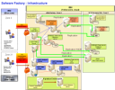
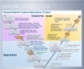
AIRBUS Software Factory choose DST Smart Cloud Dev & Test solutions for their New Delivery Operating Model of Applications Development.
Context (eBird video) (23 April 2013 Airbus Press Release)
Airbus, the world’s leading aircraft manufacturer of passenger Airlines, and IBM, are embarking on a new partnership to enhance the operational efficiencies of the world’s airlines. Airbus Smarter Fleet Solutions (ASFS is an Intelligent Operation Center "IOC" like solution), helping airlines manage their aircraft and customer service s, will be improved with new development models and better use of big data solutions. DST provides to Airbus Software Factory (an ASFS's subset of the project) all the development platforms thru the cloud (IT, OS, middleware, solutions, managed security , development tools & Application consultancy) to develop a new Delivery Operating Model for future AIRBUS ASFS Applications releases.
Solution & Technical elements
More than 100 cloud VMs provided to support development of 32 applications and integration/qualification test of 22 applications :
54 servers (212 vCPUs; 464 Gb RAM; 11.5 TB)
25 Linux; 78 Windows; Mac OS with Visual Xcode; Desktop XWIN 7; Red Hat Server; Windows 2008 Server;
Two cloud development sites for redundancy (cloud DST – SCE), Network Yellow zone, ITSC104 compliance, Backup facilities.
Application development & Dev tools support
Financial Data: Large GBS deal: TCV $120M over 7 years (DST deal: $ 9M)
Technology Benefits
Transforming time into value
Optimized resources utilization
Network Security & Redundancy
Fast start, Agility, Flexibility & Scalability
10 Cloud VMs provided in 3 days after the Go, easy ramp up to 50 VM’s in few months (ORACLE, TSM). Up to 100 fully featured Cloud VM’s at full configuration.
Key Benefits
Optimized cloud development environment with fast delivery was one of the key client factors to close the deal (saving time)
Client satisfaction of DST cloud Dev value –add leveraged new Airbus development projects and new DST Smart-Cloud dev opportunity (Air ARABIA)
Airbus Key Benefits
Fast, optimized, fully featured and secured access to the latest Cloud development technology helped AIRBUS resources to focus on their core competencies, accelerating time to value, improving quality and reducing defects.
Worldwide DST support answered client ticket management queries in different time zone and mitigated risks.

Slide 73

Miami Dade USA goes to DST to test development porting from COBOL
Context
Miami Dade is a blue customer with all range of IBM servers & software, including PeopleSoft solutions. Much of the development is done with COBOL on mainframe, with developers close to retirement. Opportunity for GBS to penetrate the account for Development and Test projects with following strategy :
Open the door by providing a free 30 day Proof of Concept that enables Miami-Dade to use the DST Cloud,
Have Miami-Dade pay for the continued use of DST environments to develop mainframe apps with Rational tools to mitigate erosion of mainframe COBOL developers skills.
Final target being to have all future PeopleSoft development projects hosted in the DST Cloud managed services.
Solution & Technical elements
The Cloud image includes: 6 developer workstations running on Windows 7 connecting to RTC, Rational Application Developer, and HATS (a RAD plug-in that enables mainframe application development within the Rational tools). The Miami-Dade requirement was for Miami-Dade to use the DST Cloud workstations and Rational tools to access a Miami-Dade mainframe through a VPN for developing mainframe applications, including screens and web services. DST contacted the GBS Rational practice to provide Miami-Dade with a one day HATS work session as part of the free PoC.
Financial data: TCV &2.5M signed, (DST $100K) More to come with Application development deals.
Technology Benefits
Rational tools enabled developers to quickly enhance very old applications using modern best practices and state-of-the-art software, rather than antiquated tools and techniques.
Key Benefits
First of a kind : DST Cloud development platform with Rational tools to access a mainframe through a VPN, to develop Mainframe application. Thank to HATS (a RAD plug-in that enables mainframe application development within the Rational tools).
Miami Dade Key Benefits
Developer productivity was increased exponentially. The new applications and web services were delivered in days rather than weeks.
Morale was increased because developers were able to use the latest sw tools
73

Slide 74
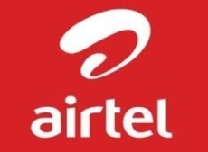
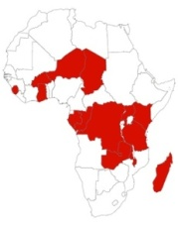
AIRTEL Telco Africa use DST Dev & Test platform for a pilot
Context
Airtel, is one of the top mobile operators in Africa, driven by the vision of providing affordable and innovative mobile services to its clients located in 17 African Countries: Burkina Faso, Chad, Democratic Republic of the Congo, and Republic of the Congo, Gabon, Ghana, Kenya, Malawi, Madagascar, Niger, Nigeria, Rwanda, Seychelles, Sierra Leone, Tanzania, Uganda and Zambia.
After a successful pilot, DST is anticipating business expansion in the rest of the 17 AirTel African Countries.
Solution & Technical elements As a pilot start in AirTel Kenya, DST has provided a development & testing environment, which can be accessed externally by AirTel developers, allowing them to utilize the following products, , including support and consultancy from DST experts: - WebSphere Commerce Server, - WebSphere Portal Server, - WebSphere Application Server, - Enterprise Content Manager, - IBM HTTP Server, DB2 Server, -Yellow Zone Demo Collab used
Deal signing:
Confidential multi million deal signed, (DST $ 200K )
Technology Benefits
Optimized resources utilization
Network Security & Redundancy
Fast start, Agility, Flexibility & Scalability
Ongoing support & maintenance for installed Middleware & Applications
IBM Key Benefits
DST Could provide this environment to the customer in a very short timeframe thanks to Cloud Technology Automation
Providing this environment was a first of a kind delivered in CEWA
First DST project in CEWA region
AIRTEL benefits
DST Could provide this environment to the customer in a very short timeframe
Saving a lot of time used to manually setup the environment by utilizing DST's expertise and automation process to achieve that
AIRTEL users were rapidly able to open remote access to the dev & tests environment on DST Cloud from outside IBM network
This project was a pilot enabling the customer to have new technology and could possible roll-out to 17 other countries

Slide 75
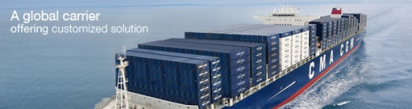

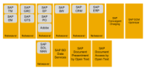
SAP Migration project: CMA-CGM choose DST Smart Cloud Dev & Test solutions for their SAP Business Blue Print (BBP)
Context:
CMA CGM (SO Large account) is the world’s 3rd largest container shipping group. In 2013 CMA took the decision to change its historical WW shipping management application by SAP as part of a large corporate project that is key for the client and for IBM. CMASYSTeMS company is the IBM-CMA joint venture & SO large account delivering IT computing for CMA CGM needs. The SAP migration project is made of 3 phases:
Business Blue Print (BBP) : High Level design prototype to validate blue print (Estimated duration : 8 Months) DST involved.
Dev&Test = SAP specific development project (multi year development project), DST on the preferred list.
Go to Production
Solution & Technical elements for Phase1
14 VMs (AIX ; Windows; SAP; Adobe: DB2; Mssql) provisioned to support BBP SAP landscape made of 18 applications.
1 Power & 1x86 servers for BBP environment (AS & DB),
42 vCPUs; 166 Gb RAM; 2.7 TB disk)
13 AIX (7.1 & 6.1); 1 Windows SRV; DB2; MSSQL
SAP SOLMAN + SAPRouter setup
VPN access from DST Montpellier to CMASYSTeMS Marseille.
Deal signing:
Large SO account , Corporate multi years project
TCV $ 28M ( DST $ 1M deal)
Technology Benefits
DST SAP expertise, DB2 provisioning and support, ssVPN fast creation/setup between site.
Optimized resources utilization
DST live demonstration shown to influence client's choice
Key Benefits
Capacity to respect short term targets was key to sign the deal
CMASYSTeMS satisfaction after SOLMAN setup was key in DST choice for whole BBP
Capacity to deliver BD2 on the cloud was key to influence client's final choice
Client Key Benefits
Fast provisioning helped to keep target, DST SAP support over passed client expectations and helped closing setup.
Capacity to choose cloud options on the catalog services like SAP support , DB2.
Optimized and secured Smartcloud Blue print environment to start SAP migration.
DST Cloud flexibility to adapt to any change

Slide 76

Cardinal Health Signature Savings Program choose DST Smart Cloud Dev Test solutions for New Delivery Operating Model of Applications Development.
Context
Signature Savings Program (SSP) is an initiative within the Cardinal Health Medical Segment to shift customer product assortment mix to higher margin and lower cost products. Due to recent loss of its biggest customer, and increasing commoditization of Medical products, SSP is a strategic priority for Cardinal Health Medical. The IBM solution will deliver the following high-level capabilities, Pricing scenario analysis, Proposal generation and output, Workflow-based approvals
Solution & Technical elements
The capabilities has been delivered through a Demand Signal Repository (DSR) solution, consisting of several key components: POSmart Foundations V 7.0 software from Relational Solutions, IBM PureData Appliance; IBM Cognos TM1, IBM Cast Iron Appliance and Custom HTML User Interface
Deal signing:
TCV: $ 8.7M (DST $2.3M)
Technology Benefits
Product and User scalability
Improved data warehouse performance
System consolidation
Key Benefits
Annual revenue growth= $30M
Annual Gross profit Improvement = $6M
Improved cycle time
Improvement in proposal completion time
Reduce/eliminate manual intervention

